Slide 1
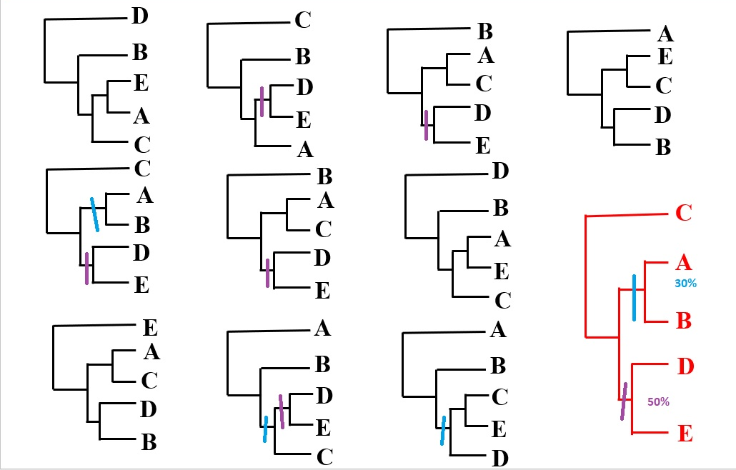
COMPULSORY ASSIGMENT

Slide 2
TESTS OF TOPOLOGY HYPOTHESES
L₁L₂L₃L₄L₅L₆
A catcga
B ccgggt
C gcggga
AU test
Calculate
„site likelihoods“ L₁, L₂, L₃, L₄, L_{5,} L₆ L₁, L₂, L₃, L₄, L_{5,} L₆
Perform permutation of
„site likelihoods“
and calculate total
Likelihood L1= L₁*L₂* L₂* L₃*L₄* L₂ L0= L₁*L₂* L₂* L₃*L₄* L₂
Calculate δ δ= lnL₁-lnL₀
Repeat many times Percent of cases, in which δ ≤ 0 is the p-value
for H0 rejection

Slide 3
TESTS OF TOPOLOGY HYPOTHESES
δ= lnL₁-lnL₀
Fraction of the green zone is p-value for H₀ rejection
P value
δ
0

Slide 4
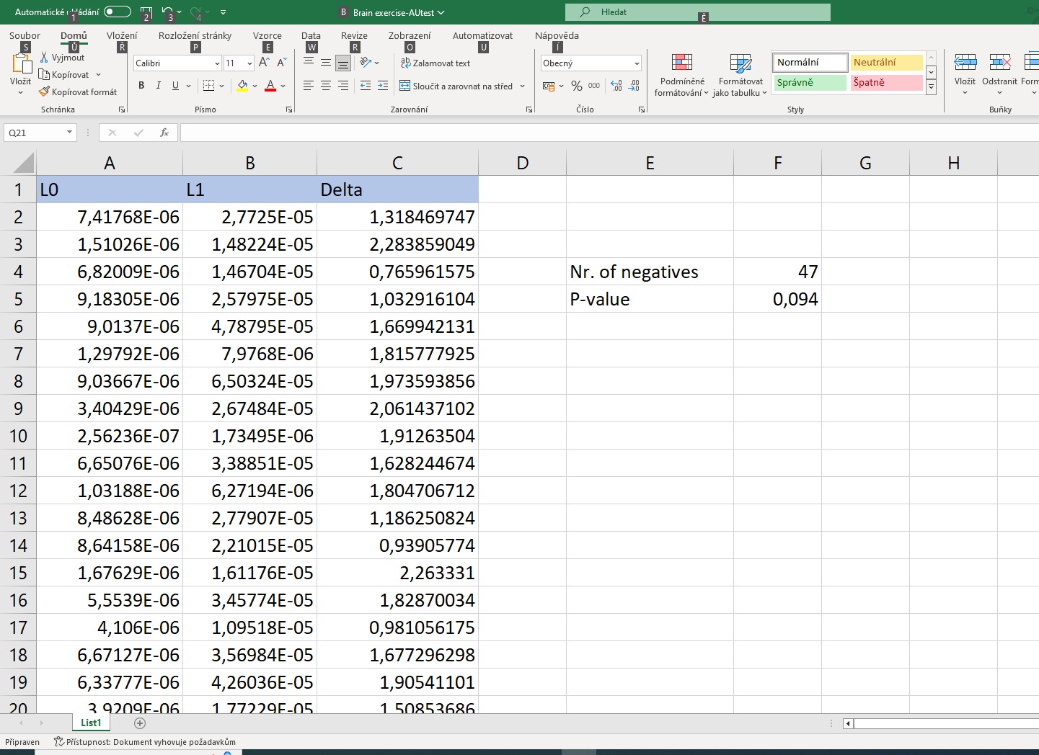
BRAIN EXERCISE

Slide 5
LIKELIHOOD RATIO TEST
In the likelihood framework we are able to test, whether the more complex model gives significantly higher likelihood than the simpler model using the likelihood ratio test (LRT).
δ = 2(lnL1 - lnL0)
lnL1….likelihood of a tree given the more complex model
lnL0….likelihood of a tree given a simpler model (null hypothesis)
The value of δ is always positive. If the simpler model is a special case of the more complex model, this statistic has χ² distribution with the degrees of freedom equal to the difference in the number of free parameter between models.

Slide 6
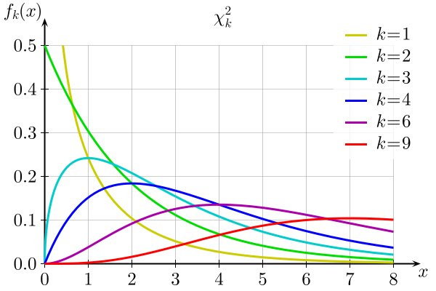
LIKELIHOOD RATIO TEST
Χ² distribution for various degrees of freedom (k)

Slide 7
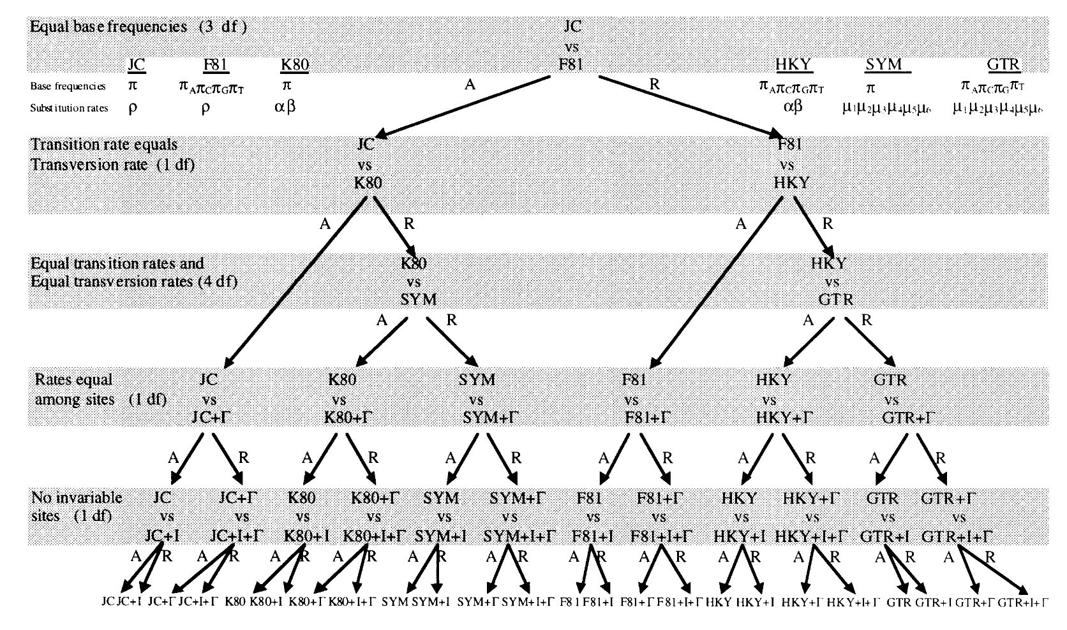
HIERARCHICAL LIKELIHOOD RATIO TEST
Implemented in Modeltest a Prottest

Slide 8
MODEL CHOICE
Akaike Information Criterion
AIC_{i} = -2lnL_{i} + 2p_{i}
Bayesian Information Criterion
BIC= -2ln(L_{i})+p_{i}ln(n)
L_{i} ……………. Likelihood
p_{i} ……………. Number of parameters in the model
n ……………. Alignment length To find a a trade off between model fit (high likelihood – low absolute value of lnL) and the number of parameters we choose model with minimal AIC or BIC
Implemented in Iqtree (Modelfinder)

Slide 9
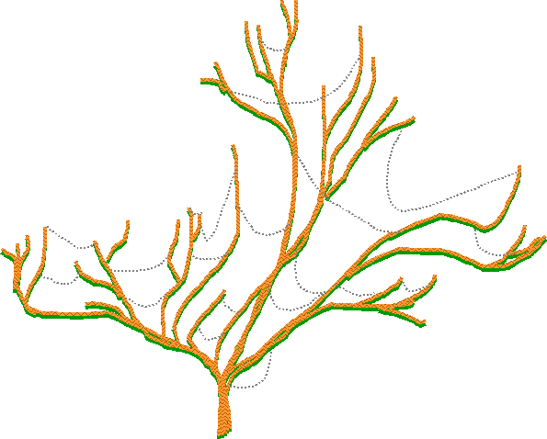
GENE TREE X SPECIES TREE
May differ because the gene history does not reflect the species history.
HORISONTAL (LATERAL) GENE TRANSFER

Slide 10
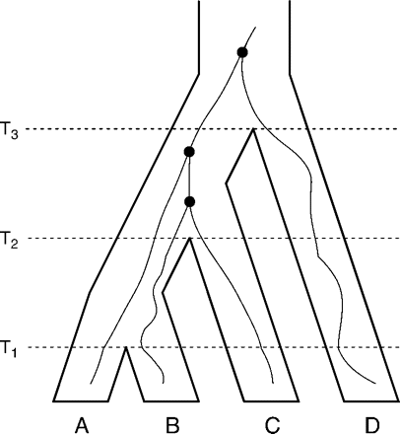
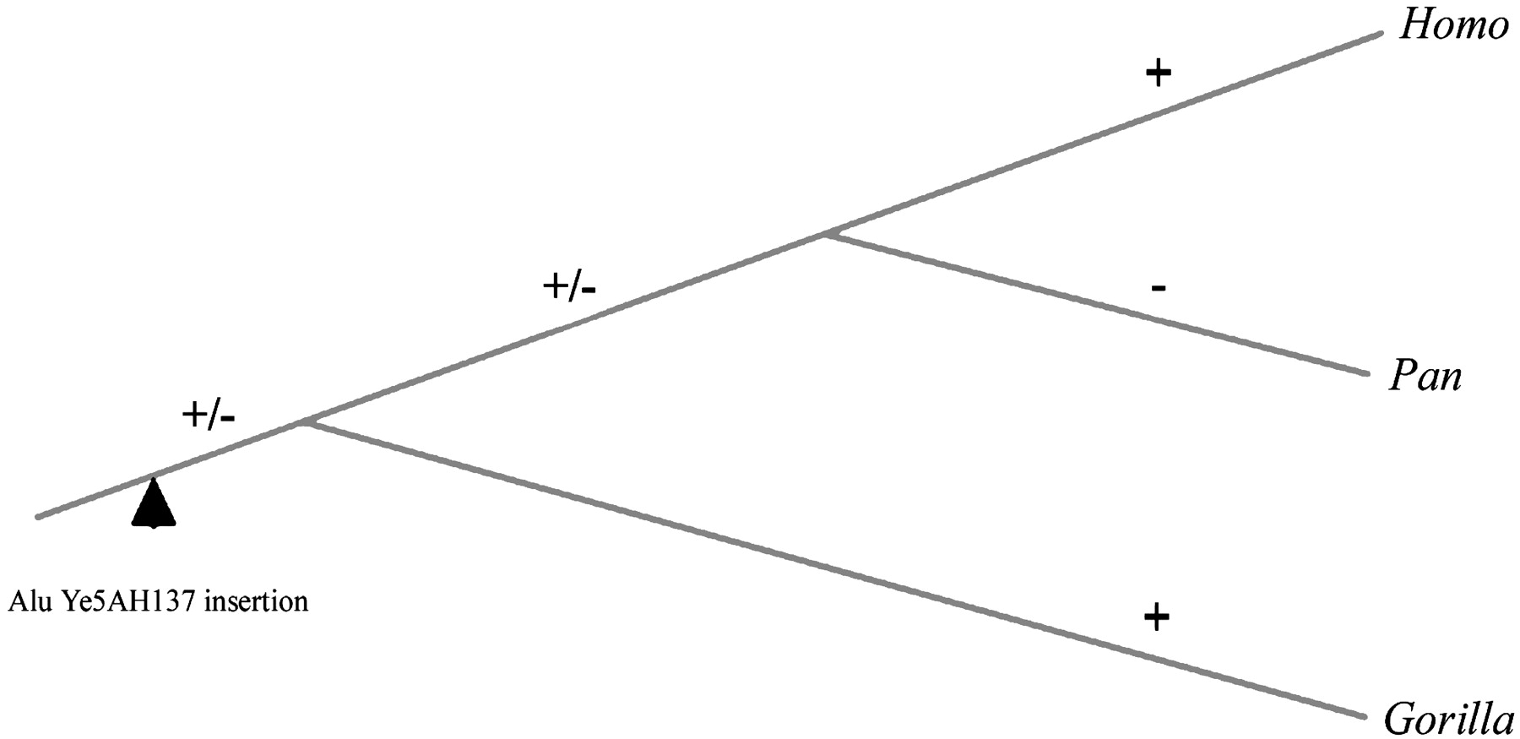
GENE TREE X SPECIES TREE
May differ because the gene history does not reflect the species history.
INCOMPLETE LINEAGE SORTING

Slide 11
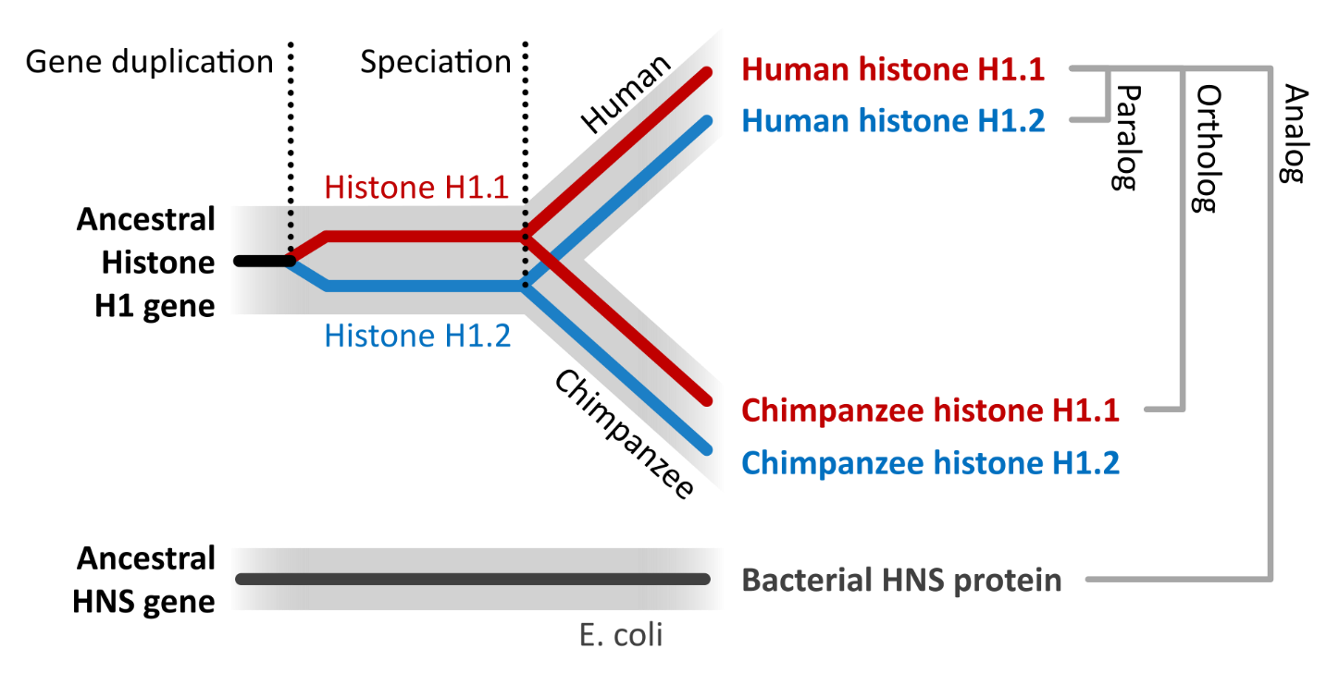
GENE TREE X SPECIES TREE
May differ because the gene history does not reflect the species history.
GENE PARALOGY
A B C A B C

Slide 12
GENE TREE X SPECIES TREE
May differ because the gene history does not reflect the species history.
GENE PARALOGY
A B C A B C

Slide 13
HOW TO CONNECT MORE DATA SETS
?

Slide 14
SUPER MATRIX
Gene 1
Gene 2
Gene 3
Gene 4
A
B
C
D
E
?
Simply join them one after the other. If a gene is missing in some taxa, we simply indicate this by a „missing“ or „unknown“ sign. If the proportion of missing characters does not exceed reasonable value, it is fine.

Slide 15
SUPER MATRIX
We call it concatenation.
We assume that those genes share the common history.
It is advisable to to use mixture models or to enable each partition to use its own subtitution model and parameters values.

Slide 16
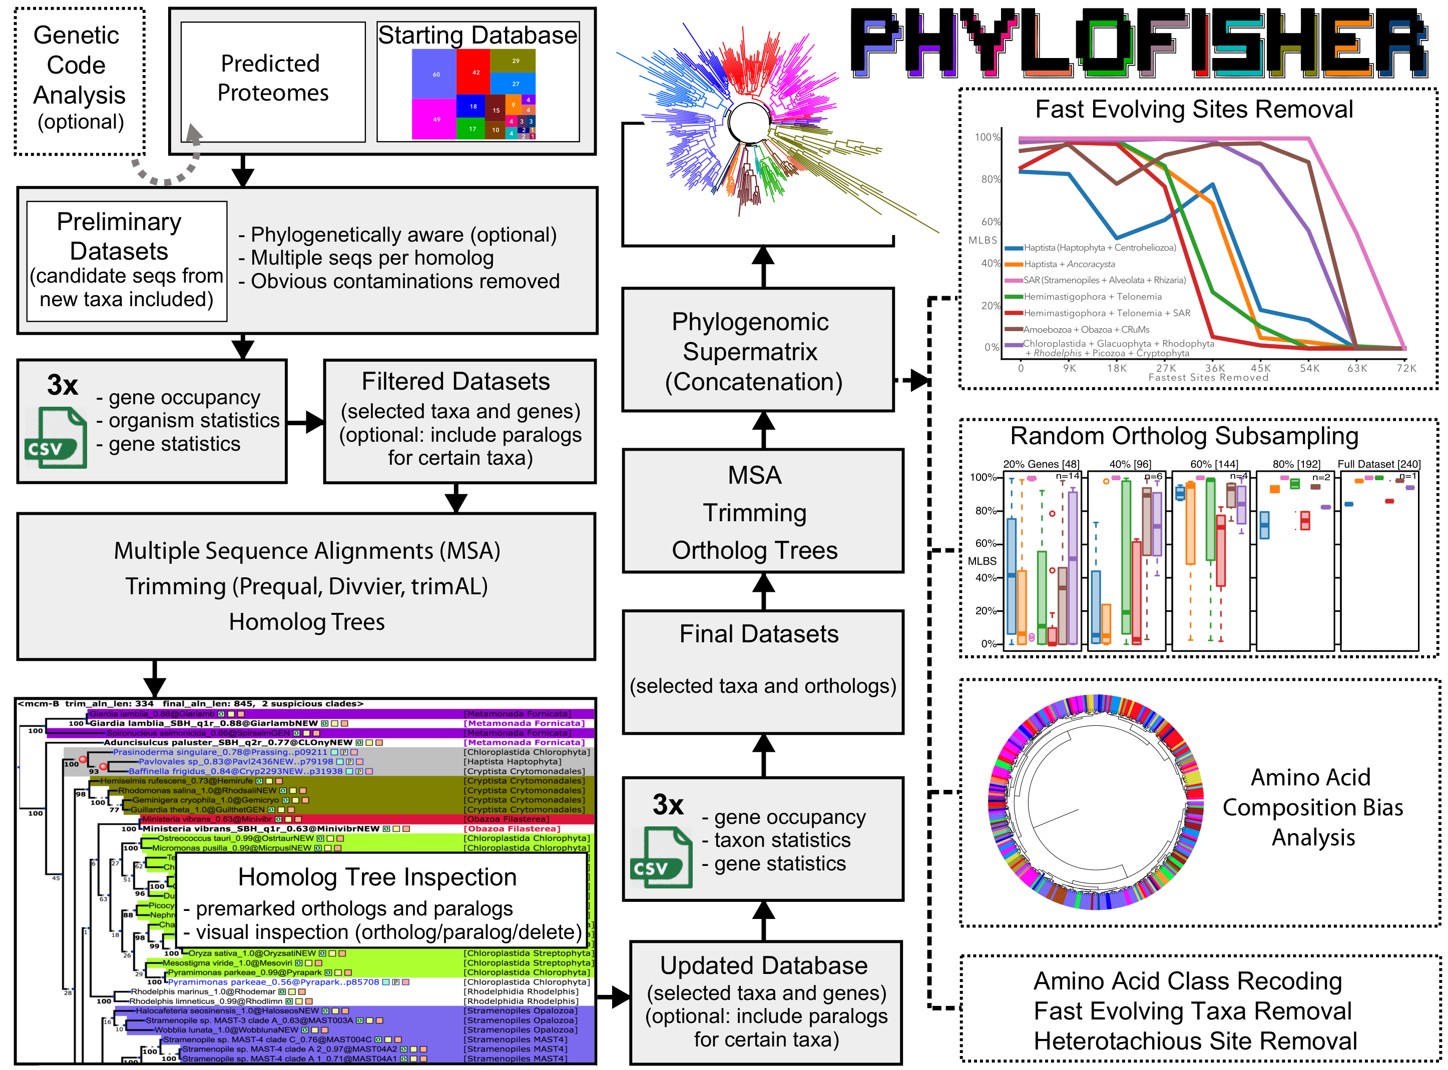
SUPER MATRIX
Tice et al. 2021

Slide 17
SUPER MATRIX
Gene 1
Gene 2
Gene 3
Gene 4
A
B
C
D
E
?
Q_{1,} α₁, …
Q_{2,} α₂, …
Q_{3,} α₃, …
Q_{4,} α₄, …

Slide 18
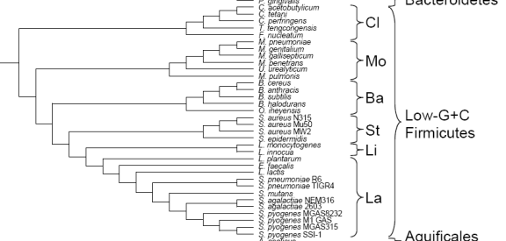
SUPERTREE
Many trees
Many alignments
One tree
We make consensus. But what if the trees differ in the composition of taxa?

Slide 19
Matrix Representation with Parsimony (Baum and Ragan, 1992)
SUPERTREE
We make an alignment from trees (?!)
Every bipartition/split represents one column

Slide 20
SUPERTREE
A
B
C
A * * * * B * * * -
C * . . *
D * . . .
E . . * -
F . . * .
From this alignment we calculate a tree using maximum parsimony
D
E
F
A
C
D
F

Slide 21
SUPERTREE
C
B
D
F
A
F
B
D
B
C
A
E
D
E
A
D
E
C
B
F
E
F
C
F
A
A
E
B
D
BRAIN EXERCISE
Construct supertree from the trees in this slide using „Matrix Representation with Parsimony„ method.
A
D
B
B
E
C
D
C
E
C
F
F

Slide 22
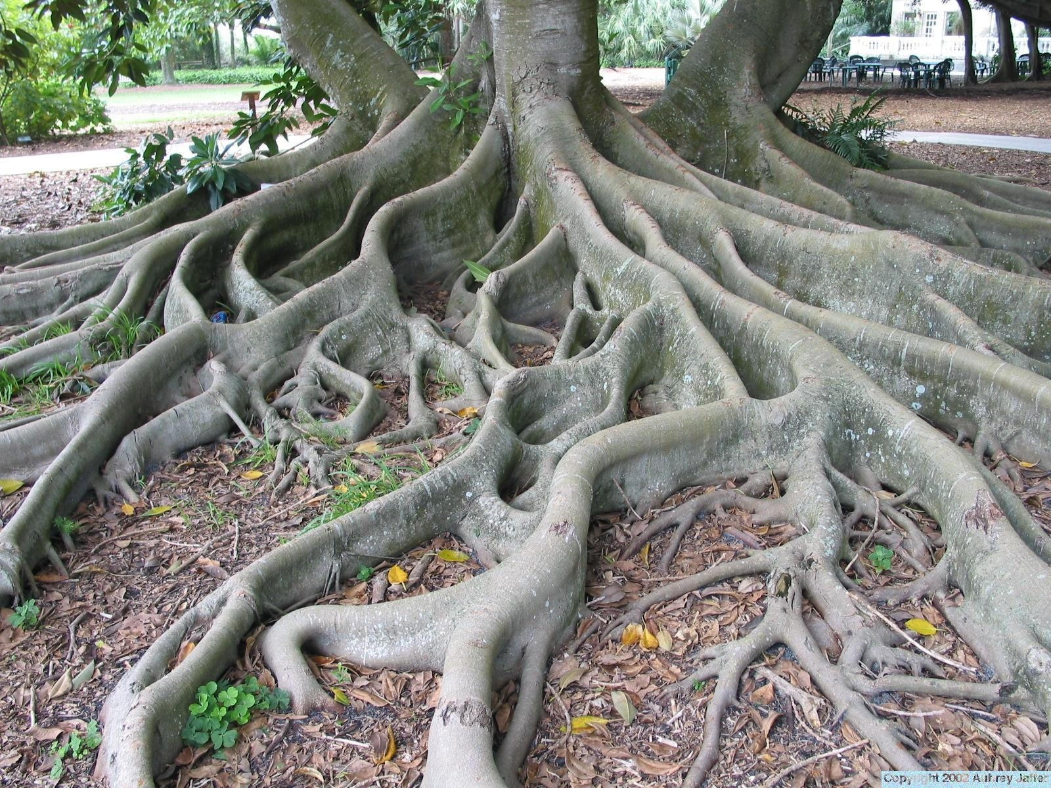
ROOTING OF TOPOLOGY

Slide 23
OUTGROUPS
All mentioned methods produce unrooted trees!!! The most common method of rooting uses „outgroups“ – organisms/sequences outside of the group we study.
Chimpanzee
Gorilla
Human
Baboon
Orangutan

Slide 24
OUTGROUPS
Outgroup points, where the root of the tree is.
Chimpanzee
Gorilla
Human
Orangutan
Baboon

Slide 25
MIDPOINT ROOT
Gorilla
Human
Chimpanzee
Orangutan
The root is placed in the middle of the longest path through the tree.

Slide 26
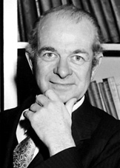
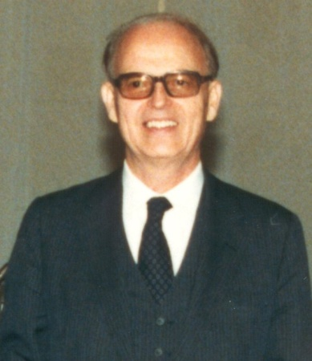
MOLECULAR CLOCK why they may work
µ – mutation rate
µ*N_{e} – nr. of mutation in population in unit of time (N_{e} = effective population size)
1/N_{e} – probability of fixation (mutation becomes substitution)
Rate of substitution
µ*N_{e}* 1/N_{e} = µ
Independent of population size!!!
Linus Pauling, Emile Zuckerkandl
(Molecules as Documents of Evolutionary History, 1964)

Slide 27
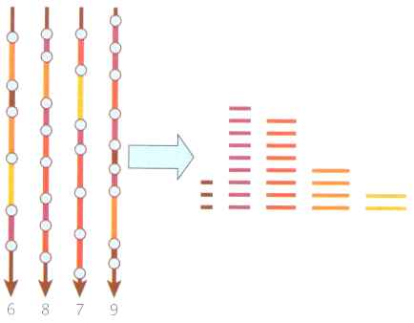
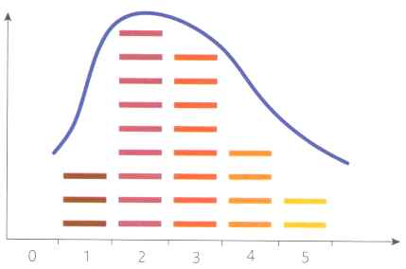
SOURCES OF ERROR sloppy pacemaker
Substitutions occur irregularly (Poisson distribution).
Intervals between events (Exponential distribution).

Slide 28
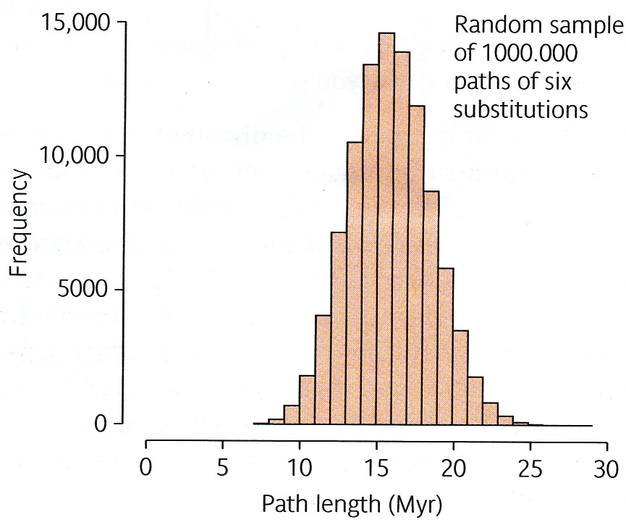
SOURCES OF ERROR sloppy pacemaker
95%

Slide 29
SOURCES OF ERROR pace varies between groups
Martin a Palumbi, PNAS USA 90: 4087-4091, 1993
10
hlodavci
psi
koně
husy
primati
medvědi
Sequence divergence (%/milions years)
1
mloci
želvy
žáby
pstruzi
velryby
želvy
mořské želvy
žraloci
0,1
0,01
0,1
1
10
100
1000
10000
100000
Body weight (kg)

Slide 30
MOLECULAR CLOCK
v
D=ut
Sekvence A
Sekvence B
Substitution rate
Time interval
D
v₁
B
v₁
t
B
v₃
v₃
t₁
v₂
C
v₂
v₅
v₅
C
t₂
v₄
D
v₄
D
t₃
v₆
A
v₆
A
Parameters Q, Γ, …, v₁₋₆
Parameters Q, Γ, … , t₁₋₃, u
Calibration point
(to ressolve the contribution ot t and u)

Slide 31
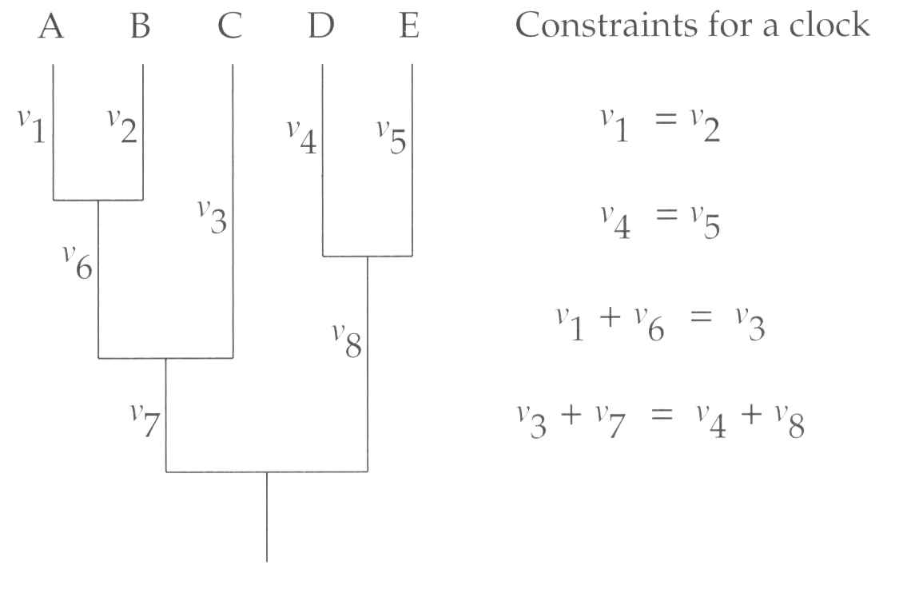
GLOBAL CLOCK
If the global clock is applied and we have at least one calibration point, we can separate on this point t (time) and μ (substitution rate). Since the equations below hold, we will use maximum likelihood method to optimise ages of the nodes t1, t3 and t4. from which the branchlengths v₁-v₈ can be calculated using global u.
v₁=v₂=t₁u
v₄=v₅=t₄u
v₃=v₆+v₁=t₂u
v₈+v₄=v₇+v₆+v₁=t₃u
t₁
t₄
t₂
t₃
t₂ is the callibration point

Slide 32
TEST OF GLOBAL CLOCK Likelihood ratio test
δ = 2(lnL1 - lnL0)
lnL0….likelihood of the tree under simpler model (global clock is valid)
lnL1….likelihood of the tree under the more complex model (no global clock)
Value of statistics δ is always higher than 0. If the simpler model is the special case of the more complex model then δ has distribution χ2 with the degrees of freedom equal to the difference in nr. of parameters (in this case 4).

Slide 33
Compulsory assignment
lnL0 = -17652.4 (global clock assumed)
lnL1 = -17646.5 (no assumption)
v₇
v₈
v₁
v₂
v₉
v₄
v₅
v₁₀
v₃
Use LRT to test, whether we can reject the hypothesis of global clock on the tree.
v₆
v₁₁
v₁₂

Slide 34
LOCAL CLOCK
Dividing the tree in several parts and in each of them we assume independent clock. For every part of the tree we need a calibration point.
u₂
u₁
t₁
t₄
t₂
t₃

Slide 35
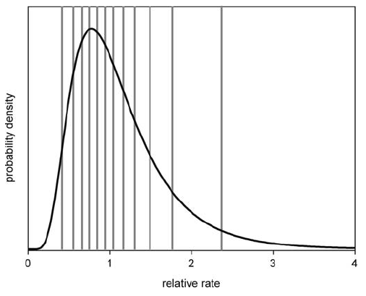
RELAXED CLOCK
For likelihood calculation, we assign branches v₁-v₈ substitution rates, which are either independent and drawn from their distribution (lognormal, flat…). Alternatively the rates of the daughter branch is derived from the rate in the mother branch using a formula.
v₁=t₁r₁u
v₂=t₁r₂u
v₃=t₂r₃u
v₄=t₄r₄u
v₅=t₄r₅u
v₆=(t₂-t₁)r₆u
v₇=(t₃-t₂)r₇u
v₈= (t₃-t₄)r₈u
t₁
t₄
t₂
t₃

Slide 36
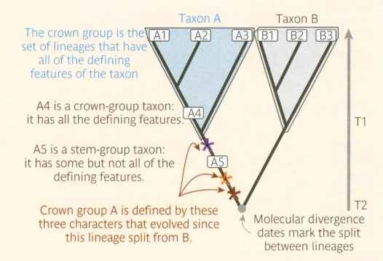
SOURCES OF ERROR calibration
Calibration points (often fossils) need to be interpreted carefully
Dating of the fossil is ucertain (confidence interval)
Position of fossil in the tree is difficult to establish.
Typically, fossils limit the minimum age of the group, because the common ancestor lived probably before the fossil.

Slide 37
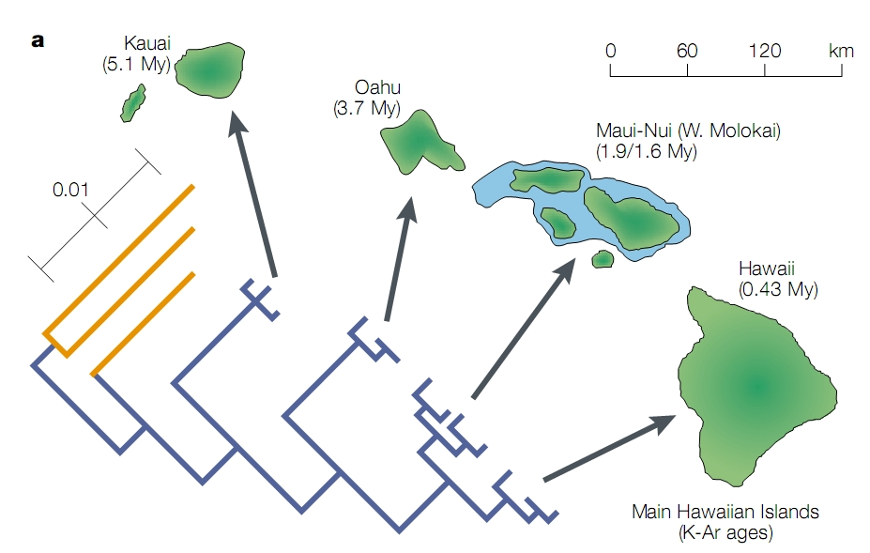
SOURCES OF ERROR calibration
Geological evidence may on the contrary limit the maximum age of the group, e.g. by the age of an island in which the endemic group lives.

Slide 38
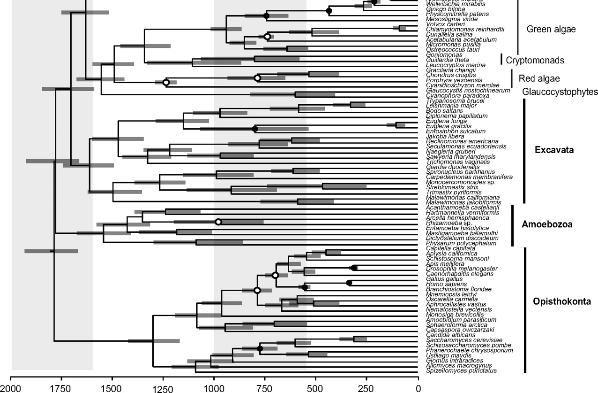
CONFIDENCE INTERVALS
Parfrey a kol. PNAS 2010

Slide 39
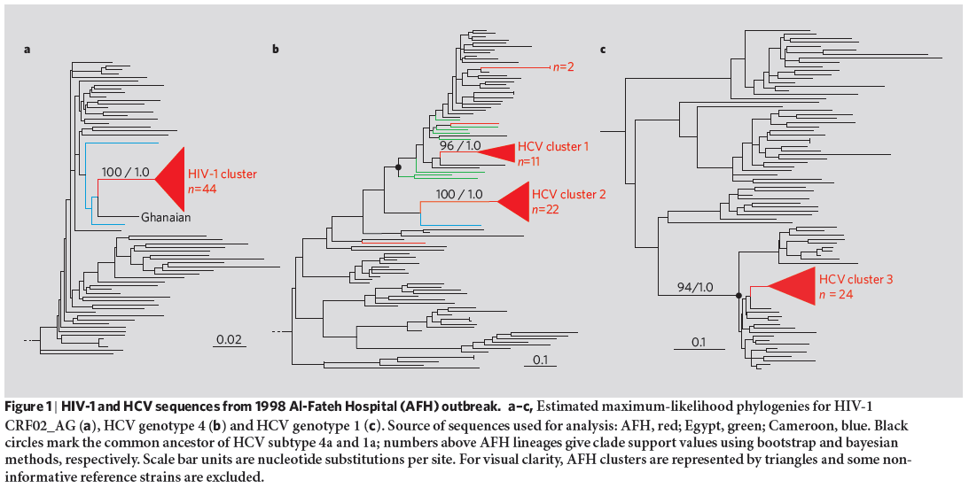
EXAMPLE
Epidemy of HIV and hepatitis C in the hospital Al-Fateh in Benhazi, Libya - 1998

Slide 40
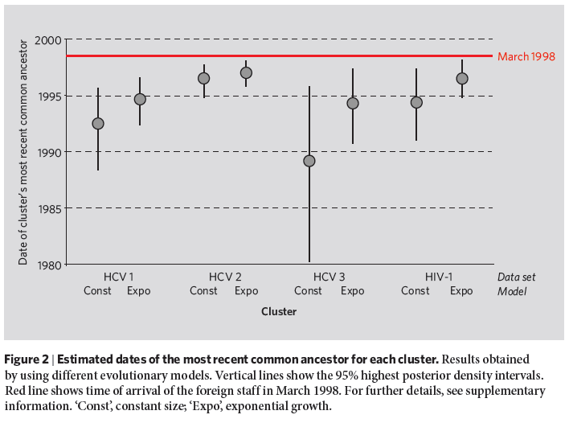
AGES OF VIRAL COMMON ANCESTORS

Slide 41
MOLECULAR CLOCK – SUMMARY
They tick irregularly, pace with uneven speed in different genes and lineages.
The pace of the clock changes during evolution.
The need for calibration and calibration points must be interpreted carefully.
The results are not a single value, but an interval. The intervals are usually uncomfortably wide, but they can still sometimes answer the question.
The more data and simpler model, the narrower the confidence intervals.
Better have wide intervals that contain the correct value than narrow intervals that are completely wrong.

