Slide 1
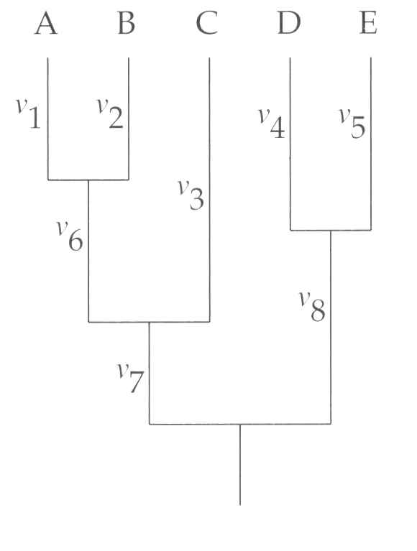
MOLECULAR CLOCK
GLOBAL
RELAXED
t₁
t₁
t₄
t₄
t₂
t₂
t₃
t₃
v₁=t₁r₁u
v₂=t₁r₂u
v₃=t₂r₃u
v₄=t₄r₄u
v₅=t₄r₅u
v₆=(t₂-t₁)r₆u
v₇=(t₃-t₂)r₇u
v₈= (t₃-t₄)r₈u
v₁=v₂=t₁u
v₄=v₅=t₄u
v₃=v₆+v₁=t₂u
v₈+v₄=v₇+v₆+v₁=t₃u
t₂ is the callibration point

Slide 2
Compulsory assignment
lnL0 = -17652.4 (global clock assumed)
lnL1 = -17646.5 (no assumption)
v₇
v₈
v₁
v₂
v₉
v₄
v₅
v₁₀
v₃
Use LRT to test, whether we can reject the hypothesis of global clock on the tree.
v₆
v₁₁
v₁₂
δ = 2(lnL1 - lnL0) = 2(-17646.5 + 17652.4) = 11,8
df= 12 - 6 = 6; χ² for 0,05 = 12.59
Clock hypothesis is not rejected

Slide 3
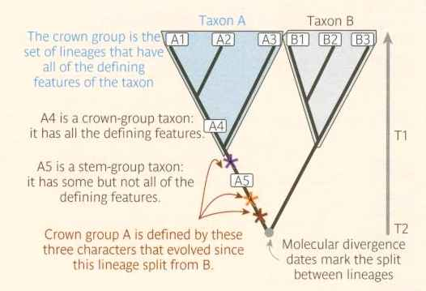
CALIBRATION POINTS
Calibration points (often fossils) need to be interpreted carefully
Dating of the fossil is ucertain (confidence interval)
Position of fossil in the tree is difficult to establish.
Typically, fossils limit the minimum age of the group, because the common ancestor lived probably before the fossil.

Slide 4
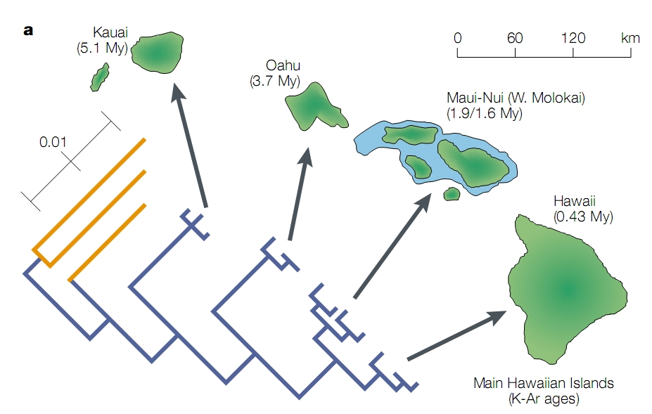
CALIBRATION POINTS
Geological evidence may on the contrary limit the maximum age of the group, e.g. by the age of an island in which the endemic group lives.

Slide 5
SUPERTREE
C
B
D
F
A
F
B
D
B
C
A
E
D
E
A
D
E
C
B
F
E
F
C
F
A
A
E
B
D
BRAIN EXERCISE
Construct supertree from the trees in this slide using „Matrix Representation with Parsimony„ method.
A
D
B
B
E
C
D
C
E
C
F
F

Slide 6
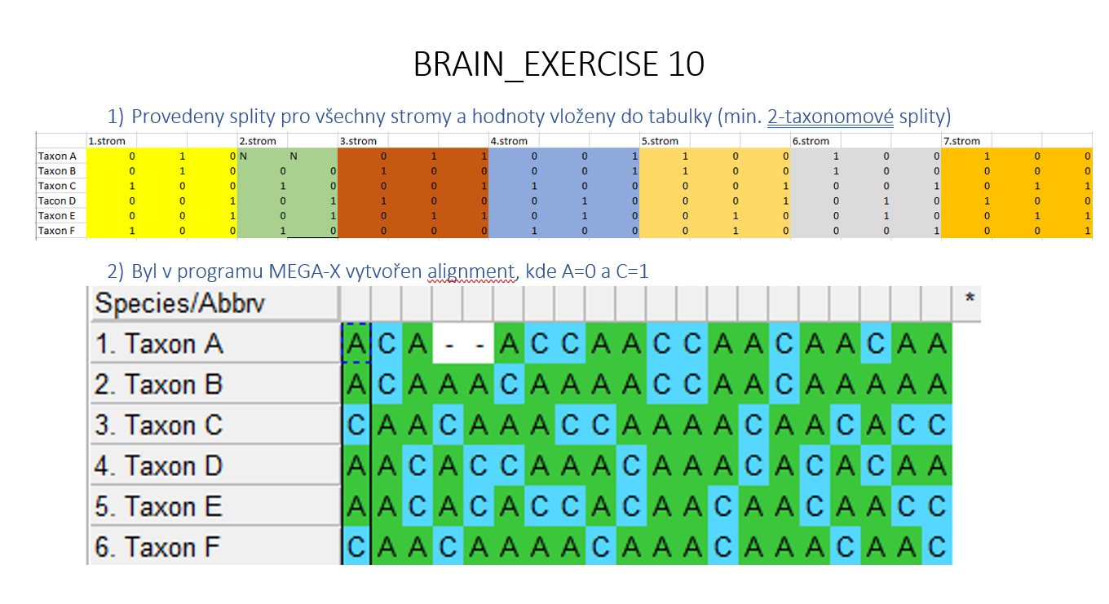
SUPERTREE
Lucie Korená

Slide 7
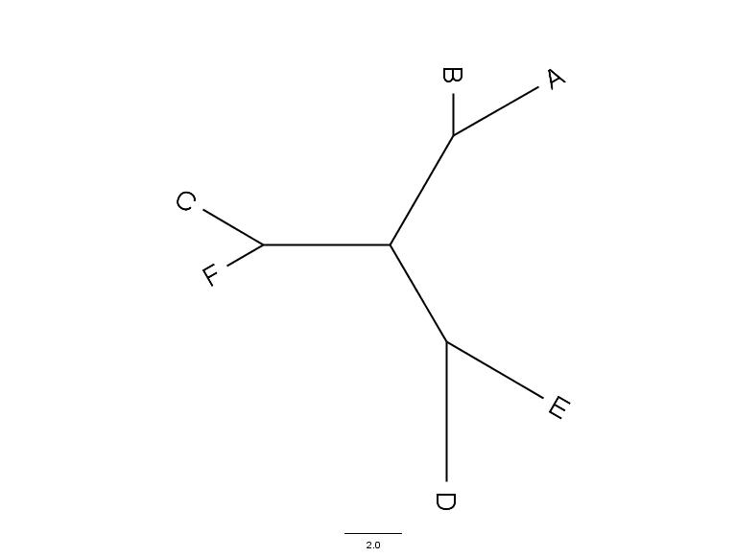
SUPERTREE

Slide 8
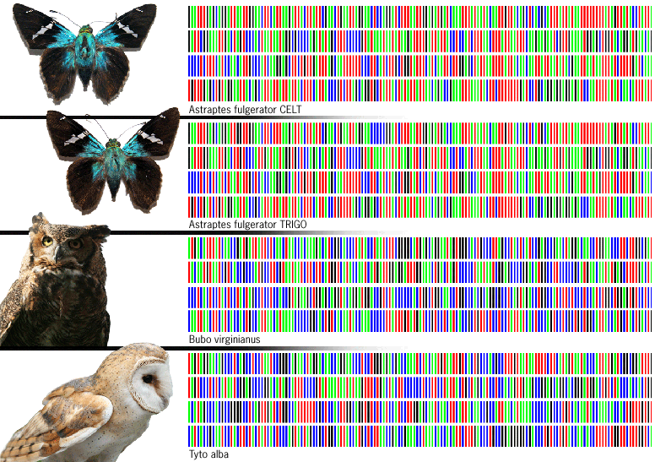
DNA BARCODING
https://ibol.org/

Slide 9
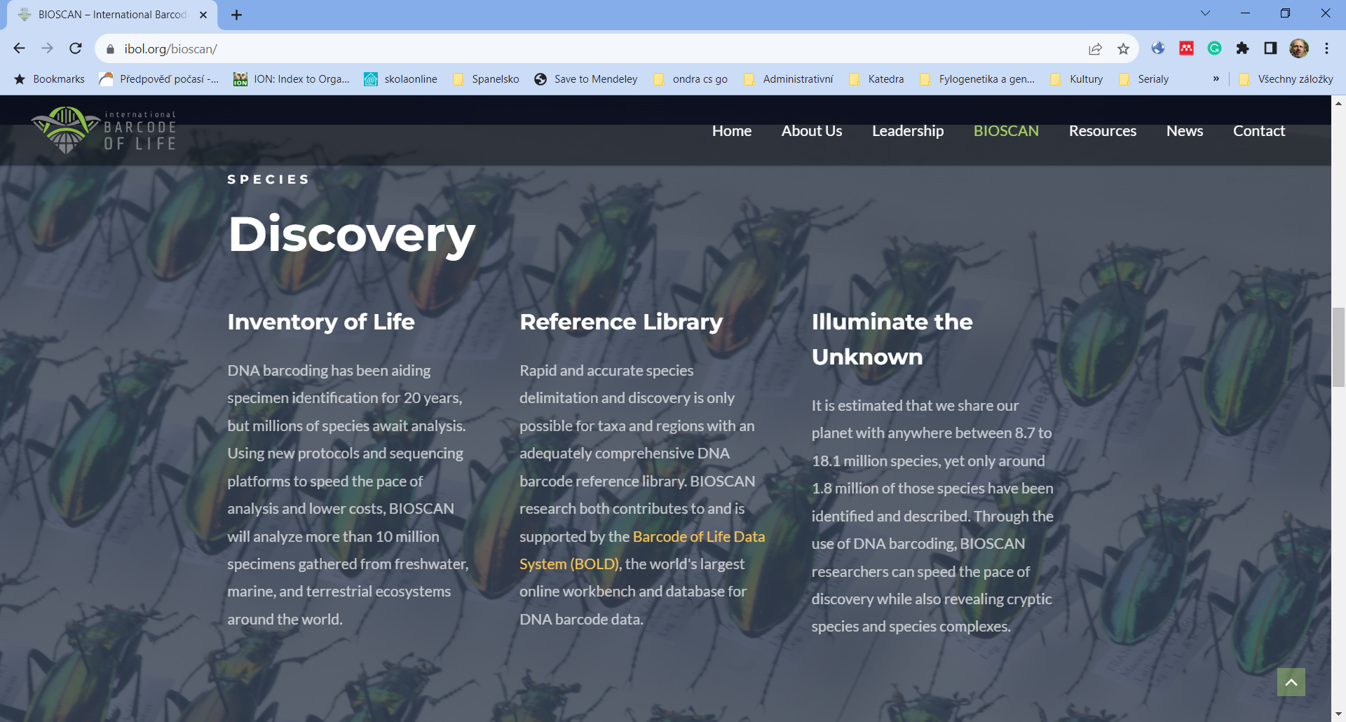
BARCODE OF LIFE

Slide 10
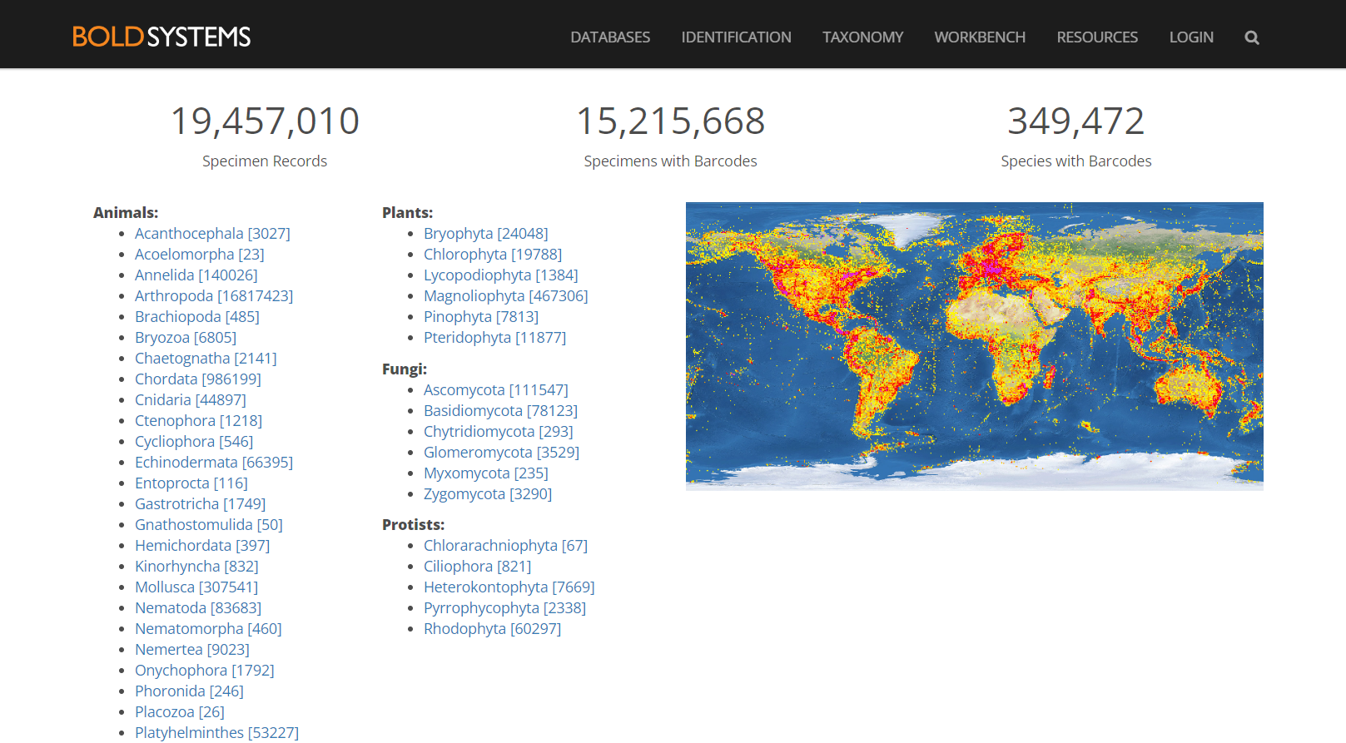
BOLDSYSTEMS

Slide 11
DNA BARCODING
Markers used for barcoding of various groups
Organism group | Marker gene/locus
Animals | COI,^{[34]} Cytb,^{[35]} 12S,^{[36]} 16S^{[37]}
Plants | matK,^{[38]} rbcL,^{[39]} psbA-trnH,^{[40]} ITS^{[41]}
Bacteria | COI,^{[27]} rpoB,^{[29]} 16S,^{[42]} cpn60,^{[28]} tuf,^{[43]} RIF,^{[44]} gnd^{[45]}
Fungi | ITS,^{[46]} RPB1 (LSU), RPB2 (LSU), 18S (SSU)^{[33]}
Protists | ITS,^{[47]} COI,^{[48]} rbcL,^{[49]} 18S,^{[50]} 28S^{[49]}

Slide 12
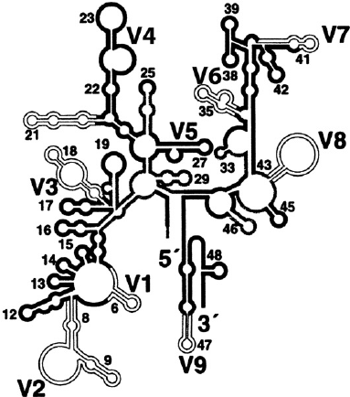
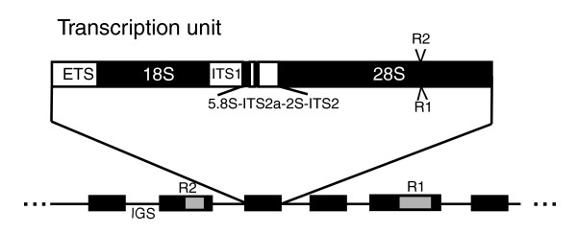
rRNA BARCODING

Slide 13
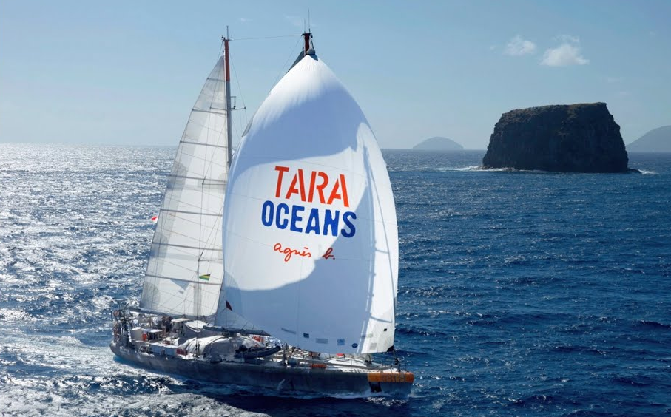
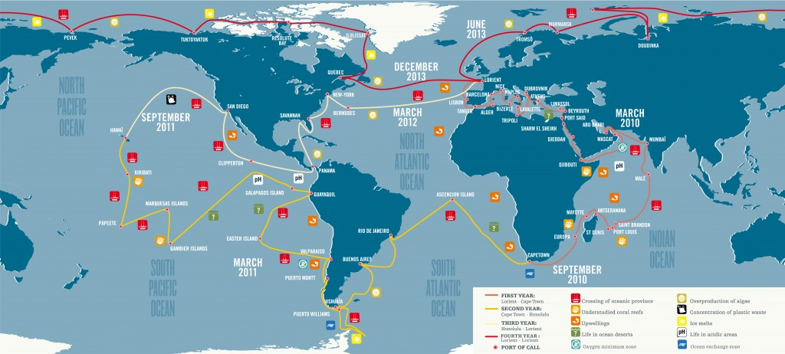
METABARCODING
Barcoding of many species at once in one mixed sample, usually from a community. The big metabarcoding project was the Tara Oceans expedition (2010-2013).

Slide 14
METABARCODING
Deiner a kol. 2016, Mol Ecol

Slide 15
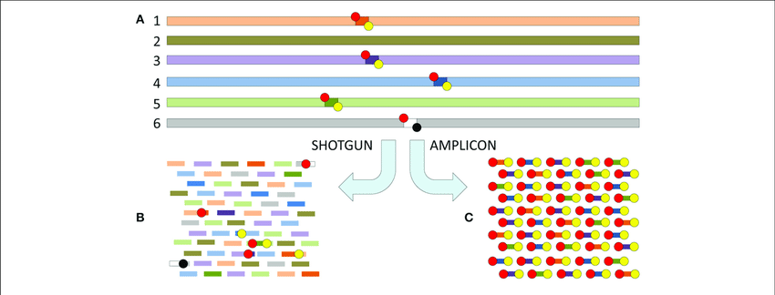
METABARCODING
!
PCR STEP
Extracting and assembling marker genes (e.g. Metaxa 2, microbiology.se/software/metaxa2)
Sekse et al. 2017

Slide 16
METABARCODING - QUESTIONS
While characterising the community we ask following major questions:
How many OTUs are there
- Comparison with the reference database
- OTU clustering de novo
To which species our OTUs correspond
- The best BLAST hit
- Placement on the reference tree
What are their abundancies
- Can be approximated by the numbers of reads, but we must be aware of PCR bias and the fact that some species may contain multiple copies of the marker in the genome.

Slide 17
OTU
OPERATIONAL TAXONOMIC UNIT
A group of organisms (related in a tree) that we study but cannot assign to a taxon. In the case of metabarcoding, OTU is used as a pragmatic proxy of a "species" because determining the boundary of a species is difficult (species definition). Sometimes OTUs derived from molecular data are called MOTUs.

Slide 18
METABARCODING - PIPELINE

Slide 19
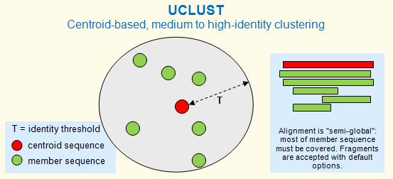
CLUSTERING
De novo clustering using a selected similarity threshold
(T), typically 97% or 99%. Diameter of OTU will not extend T from the initial sequence (centroid). If a new sequence appears outside the diameter it becomes the centroid of a new OTU. Programs UCLUST and CD-HIT.

Slide 20
CLUSTERING
De novo clustering without prior similarity tresholt – algorithm SWARM

Slide 21
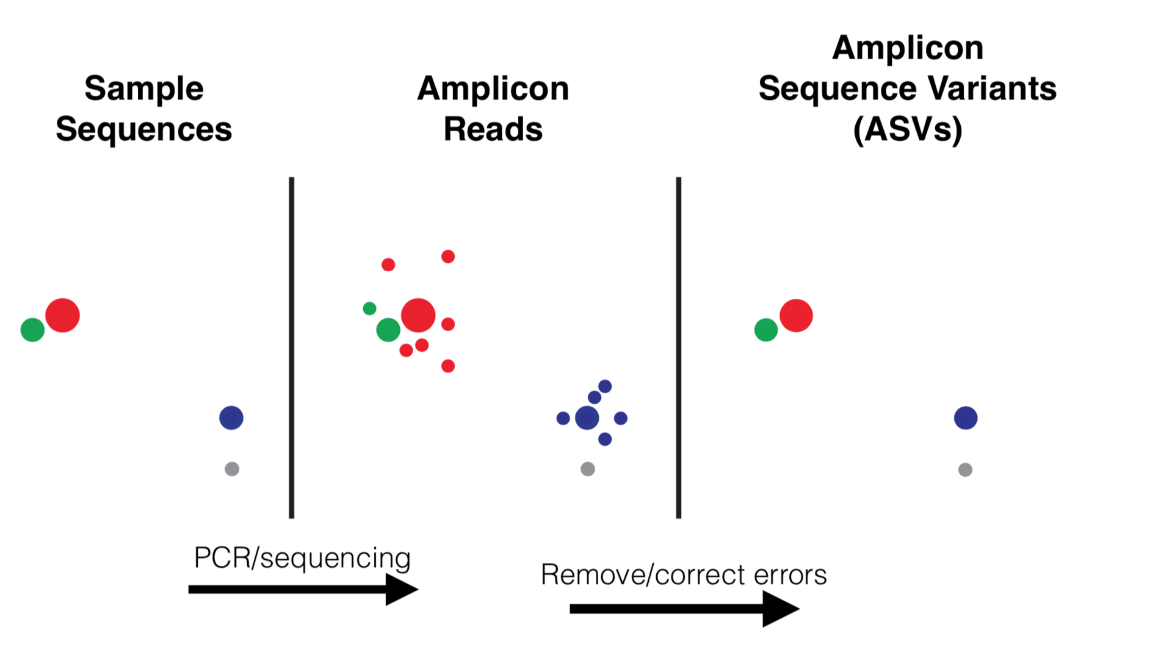
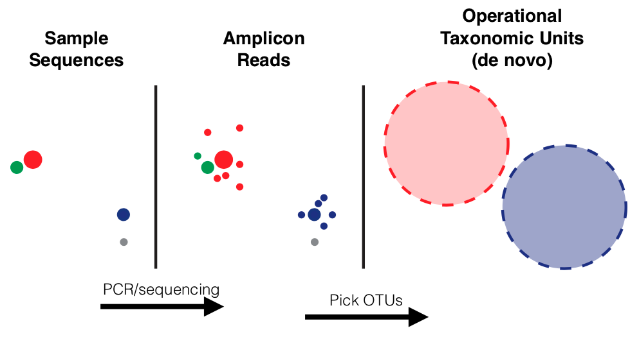
ASV
Amplicon sequence variants (ASVs) are created by removing sequencing errors, ideally should capture sequence variation in the sample, and represent finer subdivisions; they are not analogous to biological species.

Slide 22
METABARCODING - PIPELINE

Slide 23
TAXONOMIC ASSIGNMENT
The taxonomic affiliation of the representative sequences (centroids, most abundant sequences) can be determined by BLAST. However, the result is highly dependent on the composition of the database. The best hit can still be very distant if the species, from which the sequence originates, is not represented in the database.
It is better to place the representative sequences to a reference tree, i. e. a robust tree made up of reference (taxonomically determined) sequences. These sequences may be longer than our amplicons (e. g. the entire gene for SSU rRNA) if we barcode using short hypervariable regions.

Slide 24
METABARCODING - PIPELINE

Slide 25
PHYLOGENETIC PLACEMENT
We start with a reference tree with properly optimised branch lengths:
Place the new sequence step by step to all internal branches. Each time we calculate the likelihood but optimize only the lengts of the three new branches.
Place the sequence on the position yielding the highest likelihood. Robustness of placement is expressed in expected likelihood weight (ELW) – likelihood of the position divided by sum of all likelihoods.
We may use bootstraping, but we take into account only 10% best positions from the step 1.
1
2
3

Slide 26
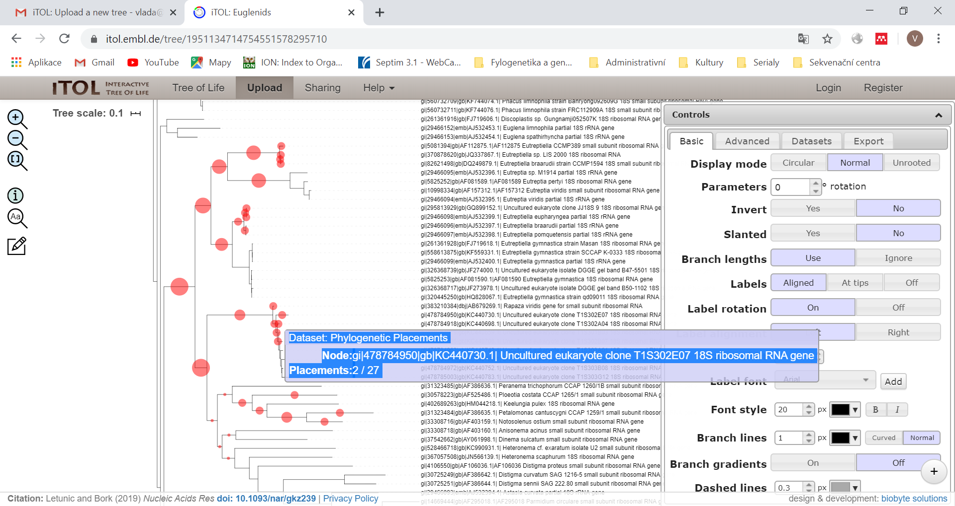
METABARCODING
Interactive tree of life (https://itol.embl.de/) – useful tool for visualisation and edditing of trees including „phylogenetic placement“ amplicons.

Slide 27


Slide 28
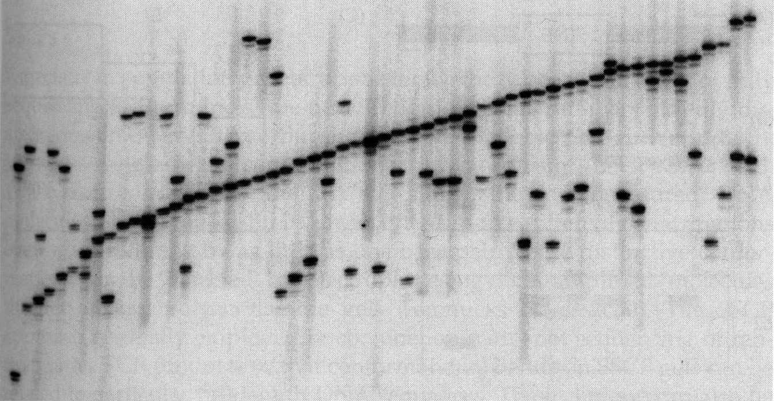
MiCrosatelites

Slide 29
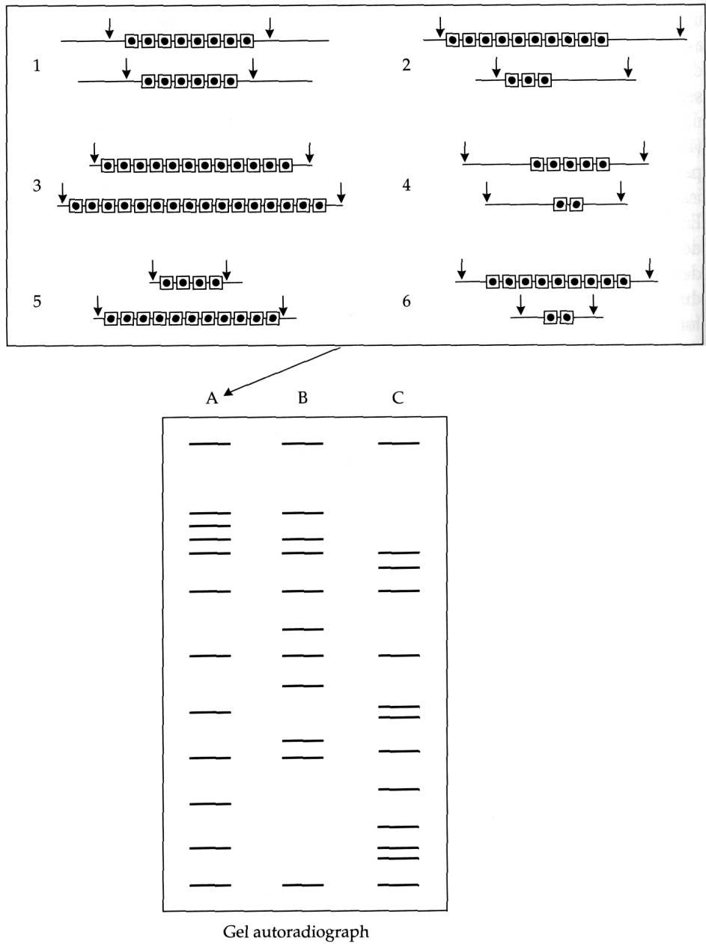
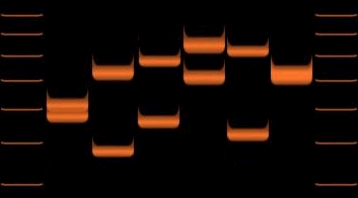
RestriCTION analYSES
VNTR – Variable Number of Tantem Repeats
Uses the polymorphism in the copy number of tandem repeats – minisatelites (10-60 nt). This polymorphism is very high even in individulas of the same species.
We digest the total DNA with a restriction endonuclease that does not cleave within the minisatellite, blot the digested DNA onto the membrane and hybridize to the labeled probe against the minisatellite if we want to visualize all loci (picture on the right), or against the minisatellite and a unique sequence in the neighborhood if we want to visualize only one locus (picture below).

Slide 30
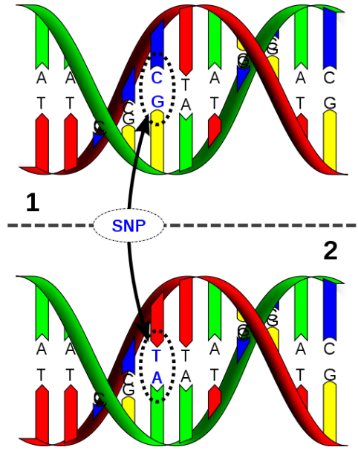
SNPs
Single Nucleotide Polymorphism
A DNA polymorphism in which individuals or species differ in a single nucleotide interchange
AAGCCTA
AAGCTTA
In this case we speak about alleles C and T. Almost all SNPs have only 2 alleles. The genomes of two people differ by about 3 million bases (not everything is SNP).

Slide 31
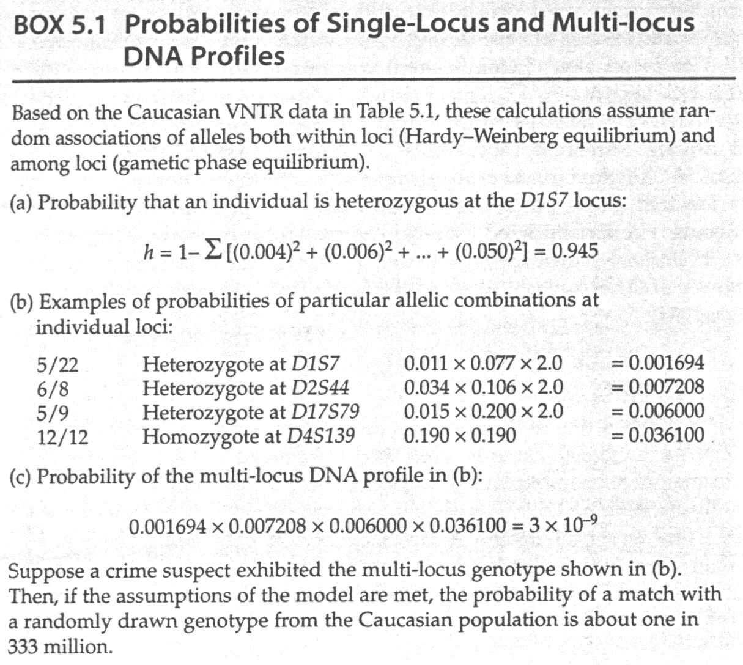
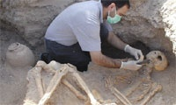
IDENTIFICATION
Determine the match of allelic profiles (e.g. between crime site and suspect).
If profiles match, determine the probability of random match – frequency of the profile in the population.
When the probability of random match becomes low enough to be neglected?
The value was arbitrarily set to 10⁻¹⁰. Most modern laboratories determine profiles with the probability or random match below 10⁻¹⁷.

Slide 32
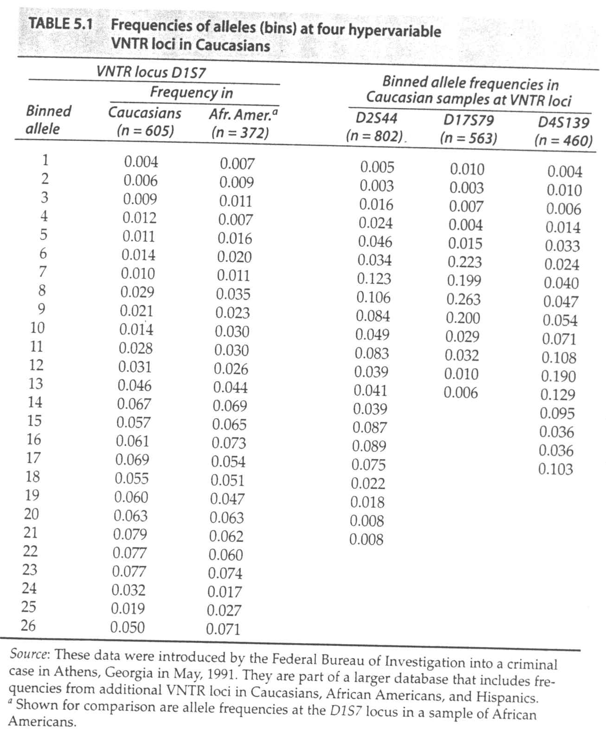
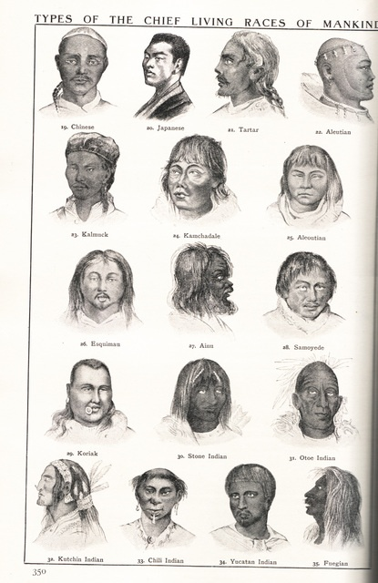
FORENSIC GENETICS

Slide 33
IDENTIFICATION
Determine the match of allelic profiles (e.g. between crime site and suspect).
If profiles match, determine the probability of random match – frequency of the profile in the population.
When the probability of random match becomes low enough to be neglected?
The value was arbitrarily set to 10⁻¹⁰. Most modern laboratories determine profiles with the probability or random match below 10⁻¹⁷.

Slide 34
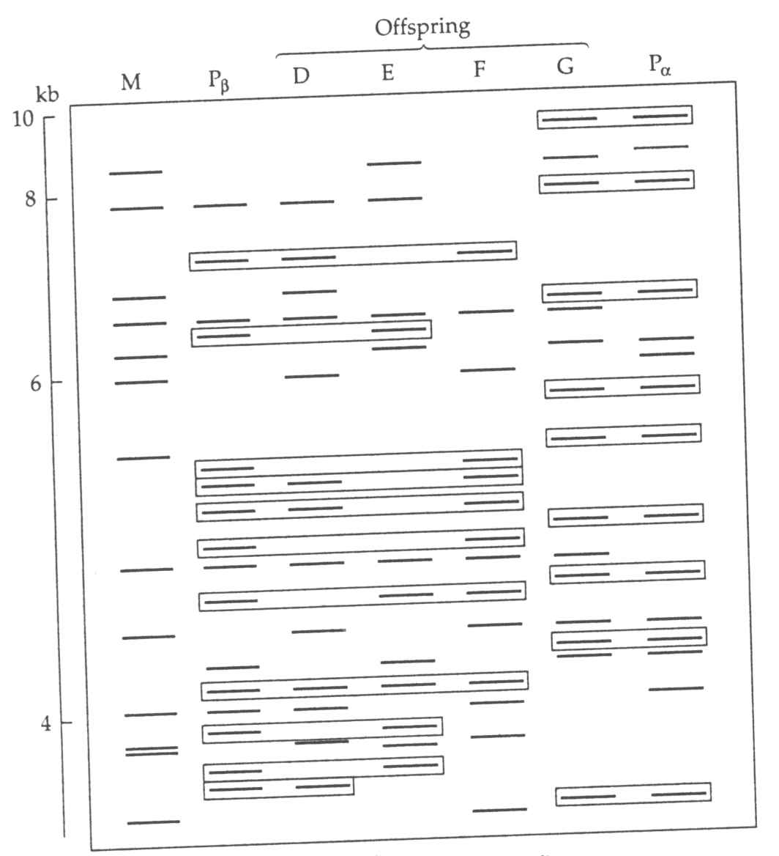
PATERNITY IDENTIFICATION
As in the case of identifications, microsatellites, VNTRs (minisatellites) and SNPs are usually used. After deducting the characters from the mother (M), the remaining characters must come from the father (Pα or Pβ). The probability of paternity is calculated on the basis of these features as in the case of individual identification.

Slide 35
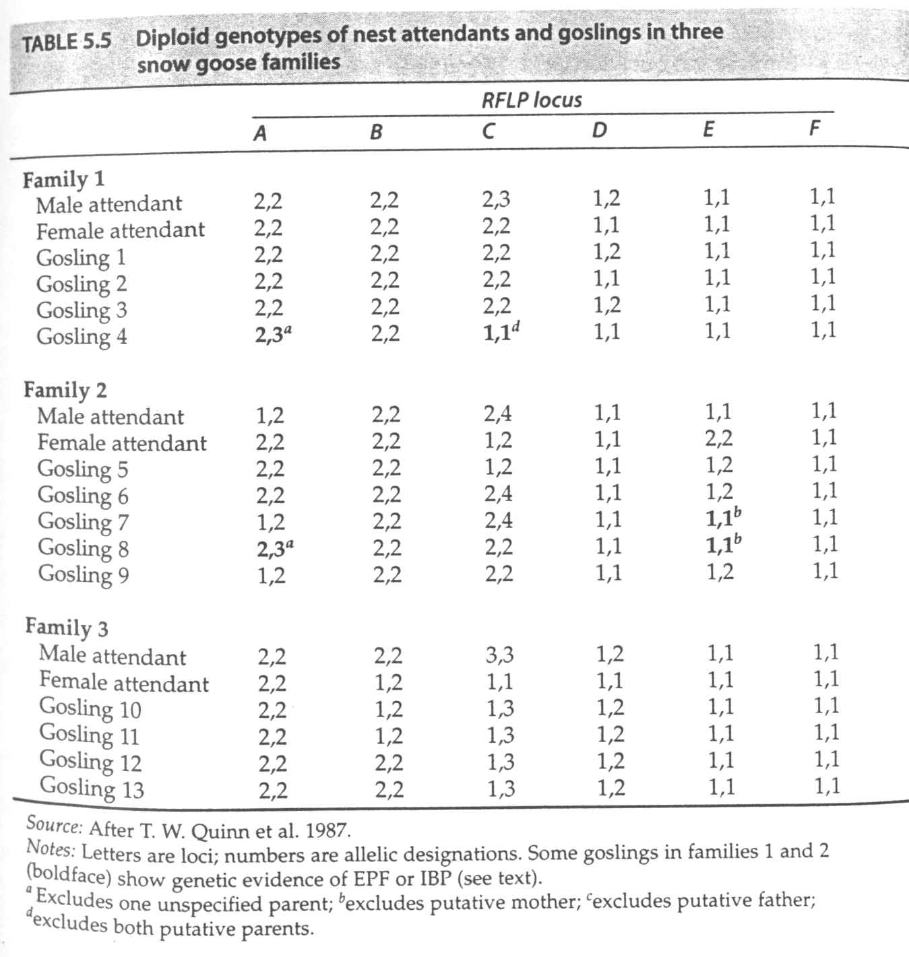
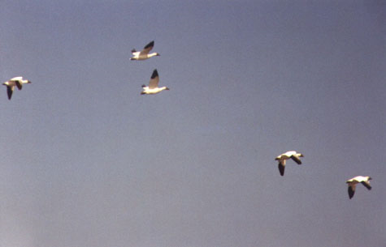
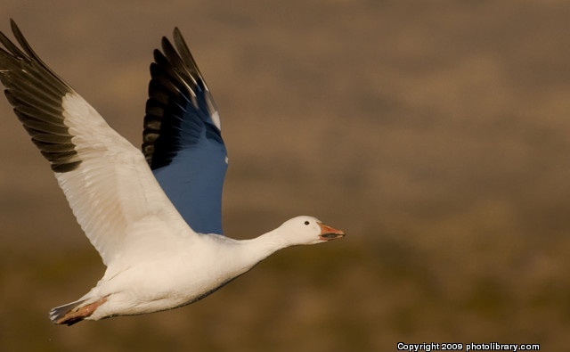
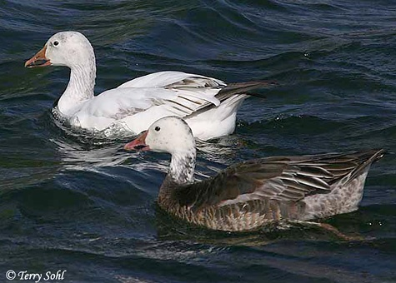
SNOW
GOOSE

Slide 36
ASSIGNMENTS
Compulsory assignment: Determine, which of the putative fathers may be the father of the child.
Brain exercise: Calculate the frequency of any potential fathers in the population of Czech Republic and Europe and how many potential fathers are in these population.
STR locus | Child | Mother (French) | Father 1 | Father 2 | Father 3
D1S1656 | 12, 17 | 17,11 | 17, 13 | 9, 12 | 12, 20
D2S1338 | 17, 19 | 17, 17 | 19, 20 | 15, 19 | 19, 23
D2S441 | 9, 16 | 10, 16 | 9, 16 | 9, 13 | 13, 16
D3S1358 | 13, 19 | 13, 14 | 15, 19 | 14, 19 | 19, 10
D8S1179 | 11, 16 | 11, 13 | 12, 13 | 16, 17 | 8, 11
Allele frequencies you find here https://strider.online/frequencies

Slide 37
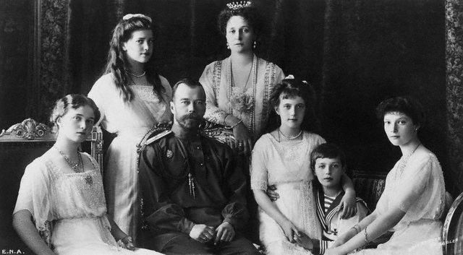
HOUSE OF ROMANOV
Tsar Nicola II and his family – Empress Alexandra and children Olga, Tatiana, Maria, Anastasia and Alexej

Slide 38
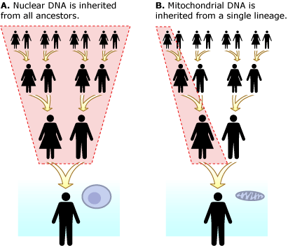
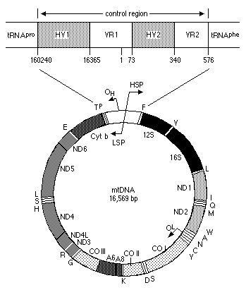
MT DNA, CONTROL REGION
Control region (D-loop), the most polymorphic region mtDNA
A haplotype (haploid genotype) is a group of alleles in an organism that are inherited together from a single parent

