Slide 1
ASSIGNMENTS
Compulsory assignment: Determine, which of the putative fathers may be the father of the child.
Brain exercise: Calculate the frequency of such a potential father in the population of Czech Republic and Europe and how many such fathers most probably are in these population.
My solution
Locus | Child | Mother | Father 1 | Father 2 | Father 3 |  | Alelle | Czech | *2 in diploid | European | *2 in diploid
D1S1656 | 12, 17 | 17,11 | 17, 13 | 9, 12 | 12, 20 |  | 12 | 0,165 | 0,33 | 0,129 | 0,258
D2S1338 | 17, 19 | 17, 17 | 19, 20 | 15, 19 | 19, 23 |  | 19 | 0,107 | 0,214 | 0,108 | 0,216
D2S441 | 9, 16 | 10, 16 | 9, 16 | 9, 13 | 13, 16 |  | 9 | 0,0025 | 0,005 | 0,00127 | 0,00254
D3S1358 | 13, 19 | 13, 14 | 15, 19 | 14, 19 | 19, 10 |  | 19 | 0,0075 | 0,015 | 0,0125 | 0,025
D8S1179 | 11, 16 | 11, 13 | 12, 13 | 16, 17 | 8, 11 |  | 16 | 0,02 | 0,04 | 0,0258 | 0,0516
 |  |  |  |  |  |  |  | Frequency | 2,1186E-07 |  | 1,82598E-07
 |  |  |  |  |  |  |  | Nr. Males | 5345000 |  | 373209720
 |  |  |  |  |  |  | Expected nr. potential fathers |  | 1,1323917 |  | 68,1474846
Correct solution:
Frq. homozygotes
Frq. heterozygotes
f…frequency of allele
Frequency of fathers = Π f_{i}² + 2f_{i}(1 - f_{i}) = Π 2f_{i} - f_{i}²
In the Czech Republic … 1.82*E-07
In Europe ………………. 1.61*E-07
_{i}

Slide 2
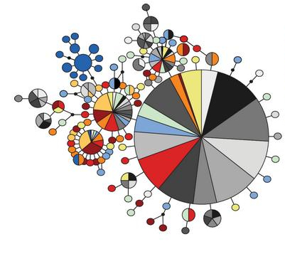
InTRASPECIFIC RELATIONSHIPS
Reifová a Munclinger – Evoluční genetika (ZS)
Černý a Čížková – Evoluční genetika člověka (ZS)

Slide 3
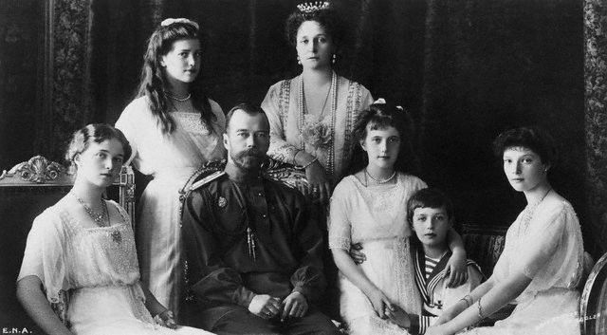
HOUSE OF ROMANOV
Tsar Nicola II and his family – Empress Alexandra and children Olga, Tatiana, Maria, Anastasia and Alexej

Slide 4
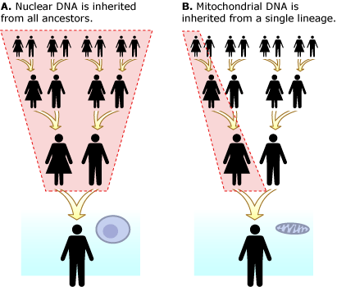
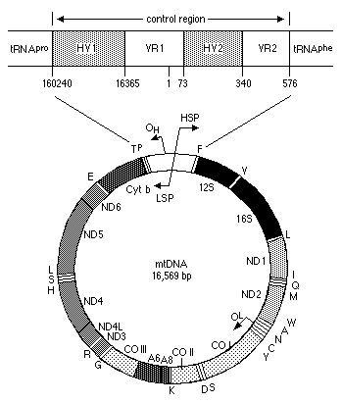
MT DNA, CONTROL REGION
Control region (D-loop), the most polymorphic region mtDNA
A haplotype (haploid genotype) is a group of alleles in an organism that are inherited together from a single parent

Slide 5
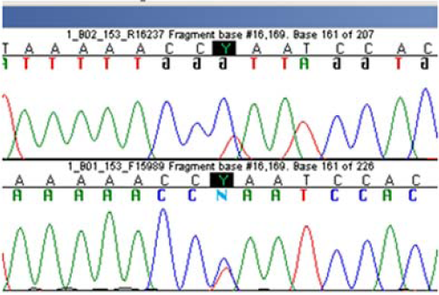
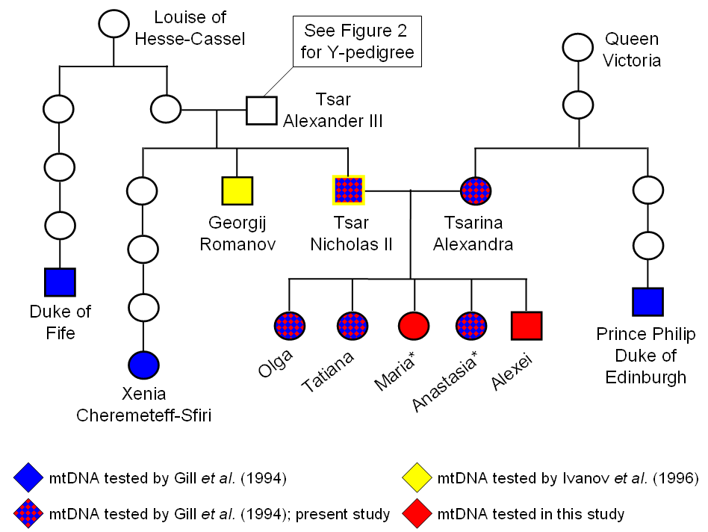
Frequecy of more common haplotype D loop Tsar (C) = 0,08%
Frequecy of D loop haplotype Empress = 0.05%
Probabilty them being random couple (not Romanov) = 0,08 * 0,05 = 0,004 %

Slide 6
HOUSE OF ROMANOV
Rogaev 2009 PNAS

Slide 7
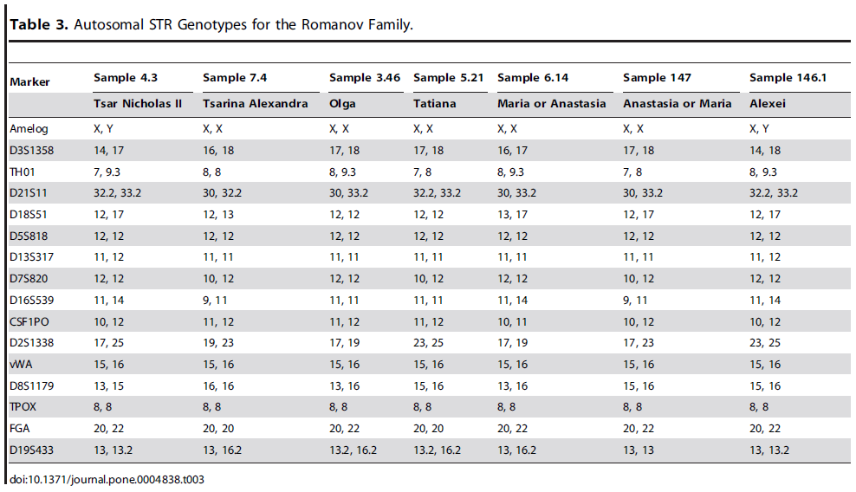
HOUSE OF ROMANOV
Coble 2009
Probability the sample is child of Tsar and Empress/
probability it is unrelated =
4*10¹²
80*10¹²

Slide 8
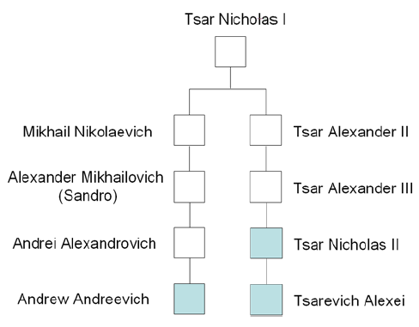
HOUSE OF ROMANOV
17 microsatelite loci on the Y chromosome showed relatedness of Tsar Nicolas II, tsarevich Alexej and Andrej Andrejevich Romanov (California) showed absolute match. Among 10 243 haplotypes in Y chromosome database YHDR none was matching this haplotype.
Coble 2009

Slide 9
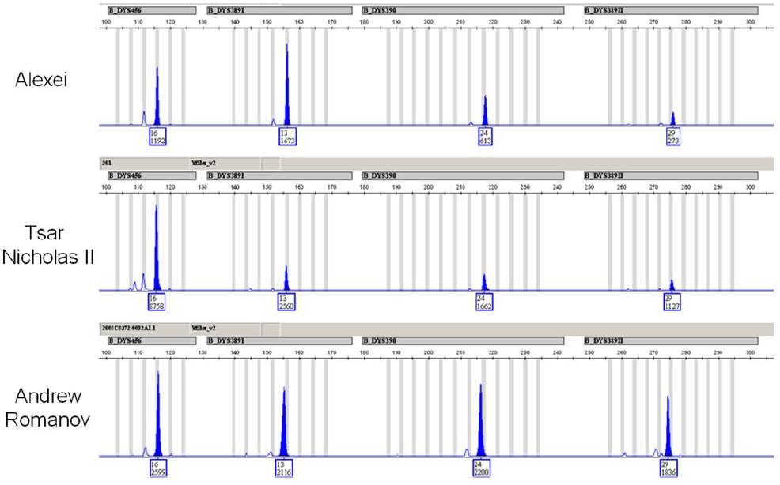
HOUSE OF ROMANOV
Coble 2009

Slide 10
INTRASPECIFIC RELATIONSHIPS
Reifová a Munclinger – Evoluční genetika (ZS)
Černý a Čížková – Evoluční genetika člověka (ZS)

Slide 11
INTRASPECIFIC ANALYSES REQUIRE DIFFERENT MINDSET AND ASSUMPTIONS
In interspecific relationships we compare fixed substitutions, in intraspecific relationships we see mutations and the polymophisms caused by them
Markers have usually low divergence.
Ancestral sequences are present in population.
Relationships are multifuctated – one ancestor creates more descendants.
Merging of lineages (recombination).
Intraspecific relationships are not hierarchical (tokogeny not cladogeny).

Slide 12
APPROACHES TO THESE ANALYSES DIFFER
HAPLOTYPE: polymorfisms on one piece of DNA
Posada a Crandal 2001

Slide 13
APPROACHES TO THESE ANALYSES DIFFER
Posada a Crandal 2001

Slide 14
Statistical parsimony
We determine the probability P1 that haplotypes different in one nucleotide were differ by one mutation (no saturation is present). If P1> 95%, which is very likely, we will combine haplotypes differing in one nucleotide into a network.
Try to solve anastomosed by identifying putative recombinations.
We determine the probability P2 that haplotypes different in the two nucleotides differ in two mutations (no saturation is present). If P2 is> 95%, we will link the networks from step 2 and the unclassified haplotypes differing in two nucleotides into a network. A non-existent intermediate stages will be introduced.
Try to solve anastomosed by identifying putative recombinations.
We will iterate the proceduse until we connect everything,
or the probability of saturation decreases below 95%.
Some parts may remain unconnected.
Program TCS
http://bioresearch.byu.edu/tcs/

Slide 15
THEORY OF COALESCENCE

Slide 16
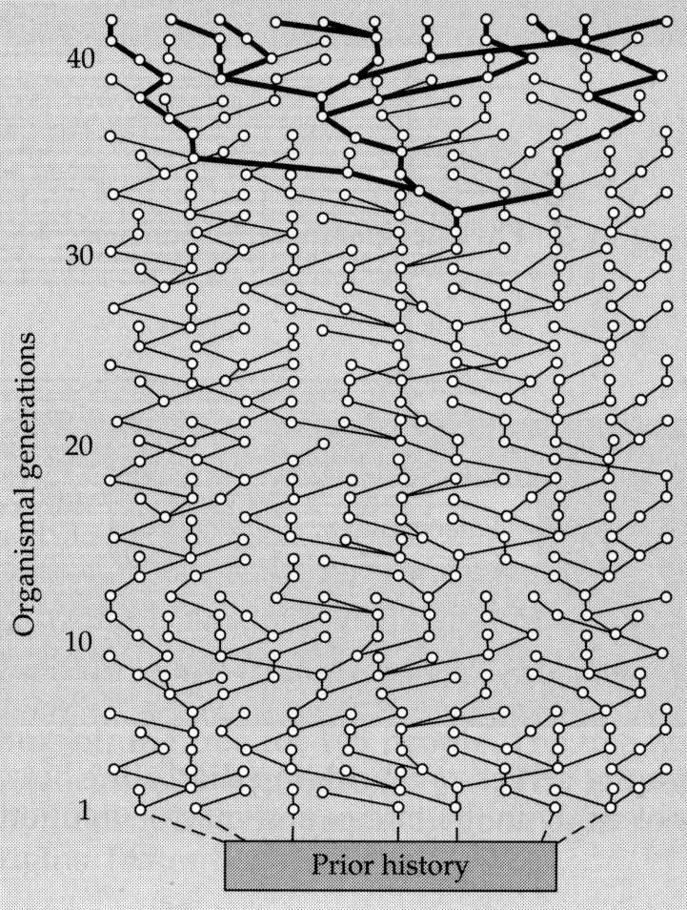
COALESCENCE POINT
MRCA – most recent common ancestor
Individual in the past, who carried ancestor of all investigated alleles of that locus.
Each non-recombining locus has a coalescent point in various individuals living in various times in the population history.

Slide 17
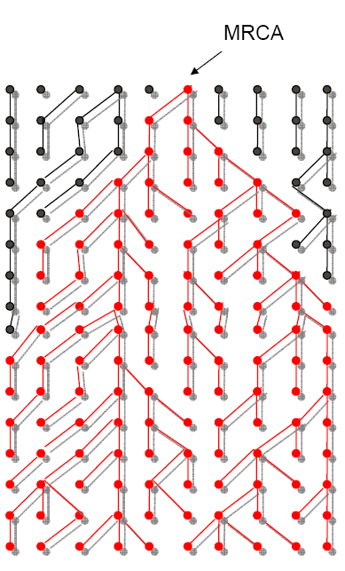
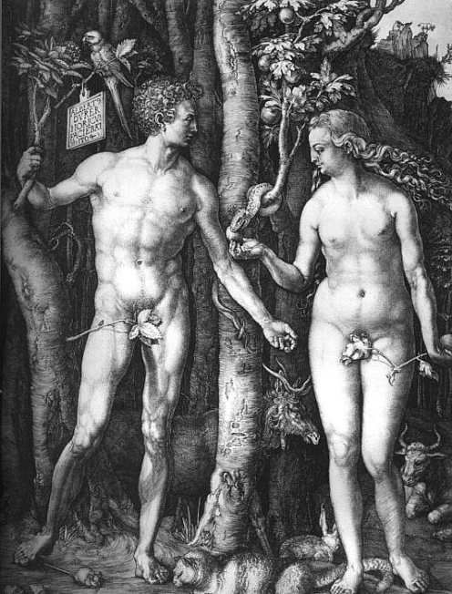
ADAM AND EVE
Mitochondral Eve
= MRCA for all extant mt DNAs. She lived in East Africa 100-240 thousand years ago.
Adam for Y chromosome
= lived in the same part of the world 100-160 thousand years ago

Slide 18
MODELING THE COALESCENCE
Stochastic model „Coalescent“
Rosenberg a Norgborg 2002

Slide 19
MULTISPECIES COALESCENT (MSC)
Assessing the probability of incomplete lineage sorting
Likelihood function in phylogenetics:
L = P(D|T,μ)
Likelihood function in the coalescence model. L is summed over all possible trees and for the set of population genetic parameters α. We are interested in α rather than the T:
L=Σ P(D|T,μ) P(T, α)
Rosenberg a Norgborg 2002
T

Slide 20
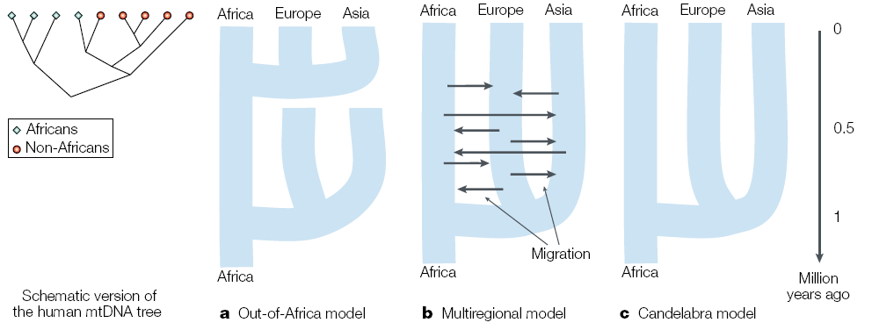
USING COALESCENT FOR TESTING HYPOTHESES
Three models of the history of human population that we consider
Rosenberg a Norgborg 2002

Slide 21
USING COALESCENT FOR TESTING HYPOTHESES

Slide 22
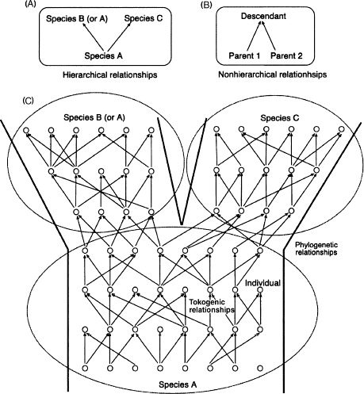
RECOMBINING LOCUS
Individual has two parents
Due to recombination and segregation, pieces of the loci mix every generation
Every locus is a mix of sections with unique history
Posada a Crandal 2001

Slide 23
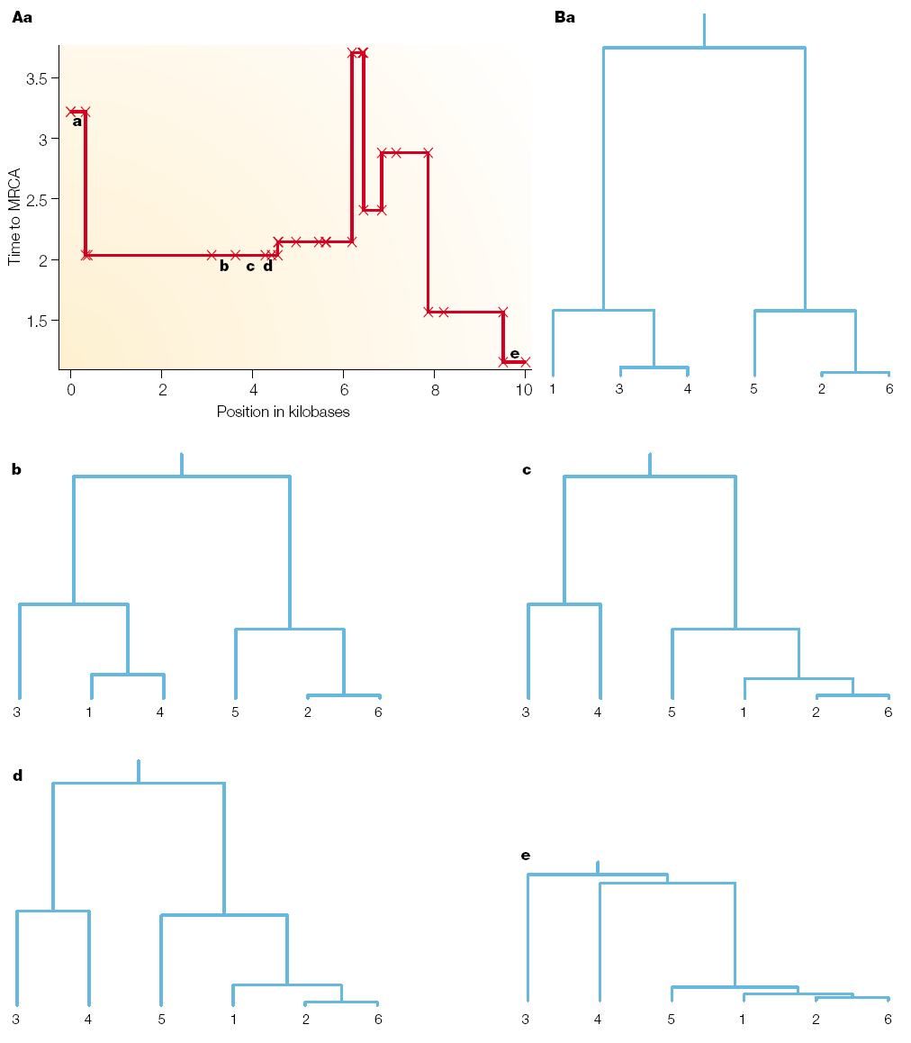
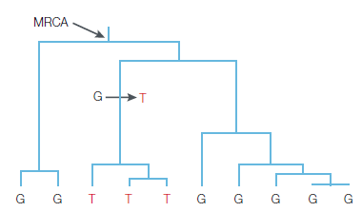
MODELING ALLELE DISTRIBUTIONS IN LIKELIHOOD FRAMEWORK
Distribution of the alleles in the population is determined by a random mutation process and genealogy (which is unknown).
Parts of the loci divided by recombination evolved under different (but not entirely independent) topologies.
Rosenberg a Norgborg 2002
Likelihood function in the coalescence model. L is summed over all possible trees and for the set of population genetic parameters α. We are interested in α rather than the T:
L=Σ P(D|T,μ) P(T, α)
T

Slide 24
END

Slide 25
EXAM
PARTS OF EXAM:
Written part (5 examples) – 10 points
Oral part (theory) – 5 points
ADDITIONAL POINTS
Homeworks (earn or loose) – 4,5 points in total
Essay (2-3 pages) and presentation – 4 points
Brain exercises – 8 points in total
EVALUATION:
11-13.5 points – dobře
14-17.5 points – velmi dobře
above 18 - výborně

Slide 26
ESSAYS
For writing an essay and its short presentation you will get 4 points for the exam. The essay should be based on one or more publications. You can choose the topic of the essay from the publications in Moodle or from other publications that will interest you. Before you start writing an essay, let me know what topic you are choosing.
The essay should have a minimum of two A4 pages with line spacing 1, font 12. In the essay, do not forget to pay close attention to the methodology used.
Submit the essay through moodle by January 6, 2022 as a pdf file. The text of the essay can be written in Czech or English, presentation in English.
Presentation online on January 10, 2021 9:00, everybody welcome

