Slide 1
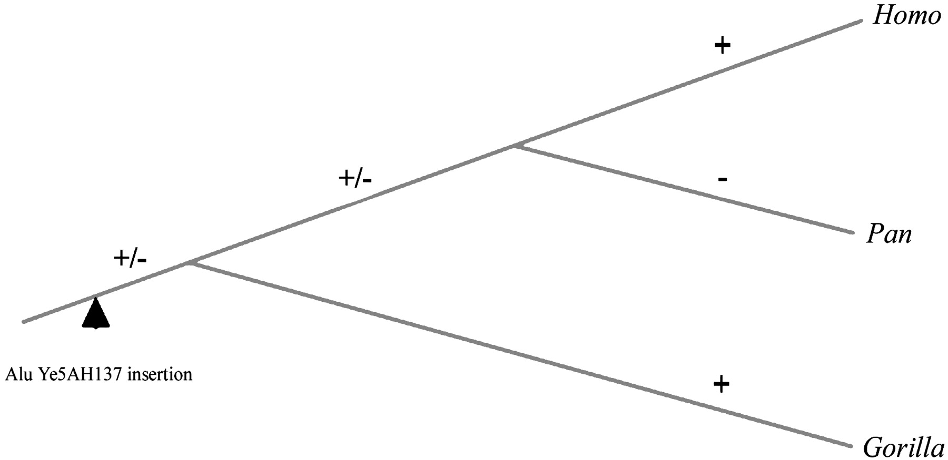
BRAIN EXERCISE
The presence of a SINE element does not correspond with the known phylogeny. It is absent in chimpanzee and we know this is not the secondary loss. No experimental error involved.
Try to explain it.

Slide 2
SOLUTION
The disagreement in the presence of SINE with the phylogeny of species may indicate "incomplete lineage sorting" – the polymorphisms in the population between two close speciation events was preserved and different alelles were fixed in descendants.
Abdel-Halim Salem a kol. 2003 PNAS

Slide 3
rECAPITULAtion
How we obtain characters by sequencing unique loci
Sequencing of loci we want to study
1st lecture
Download of homologous sequences from the database
3th lecture
Alignment
3rd lecture

Slide 4
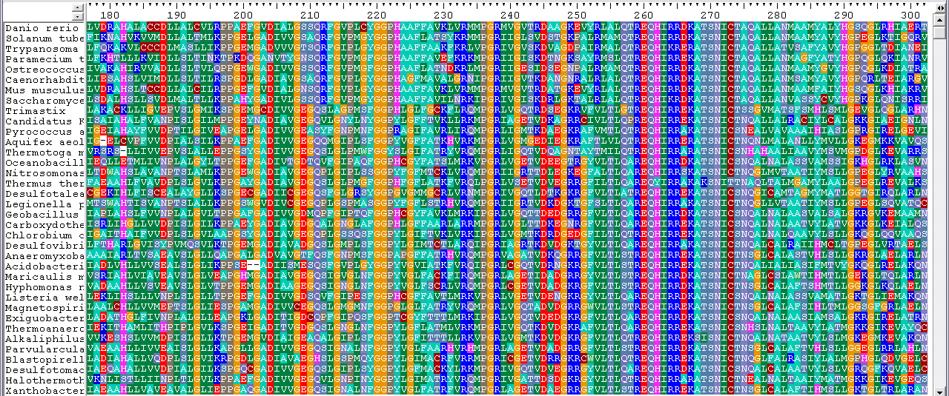
alignment
Mutliple sequence alignment (MSA)
The character is the column
Character states are AA (R, V, T, A, S, I…)

Slide 5
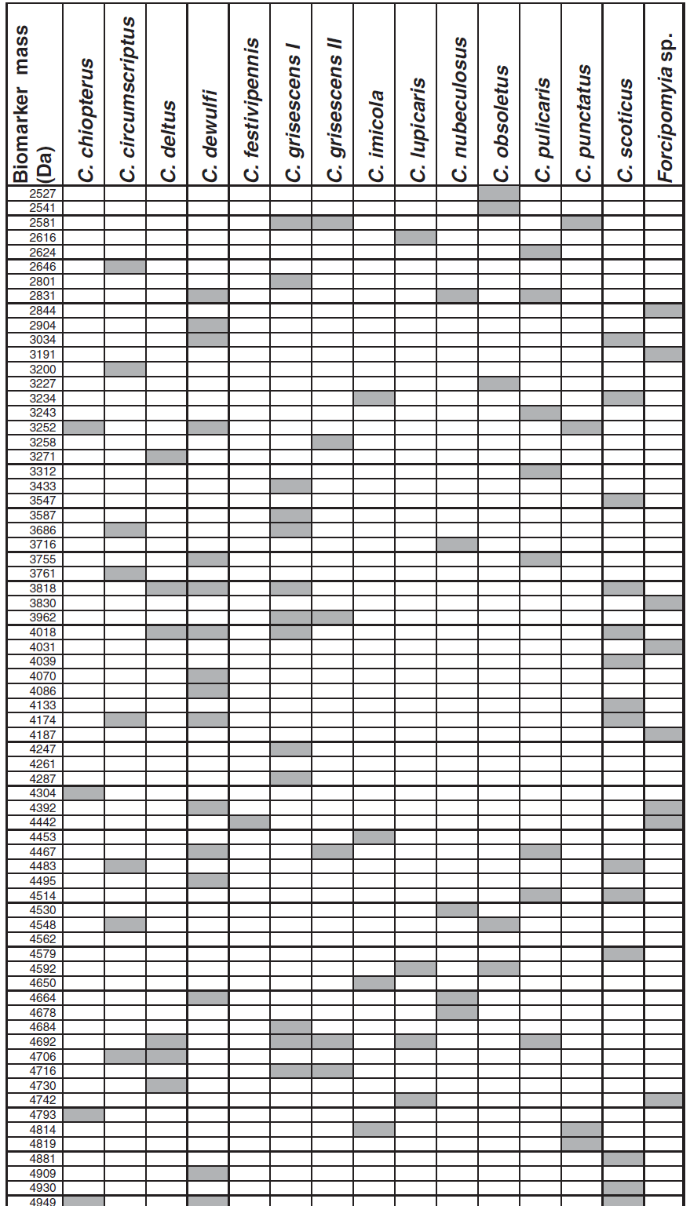
FINGERPRINT
Character is the row Character states are +/-

Slide 6
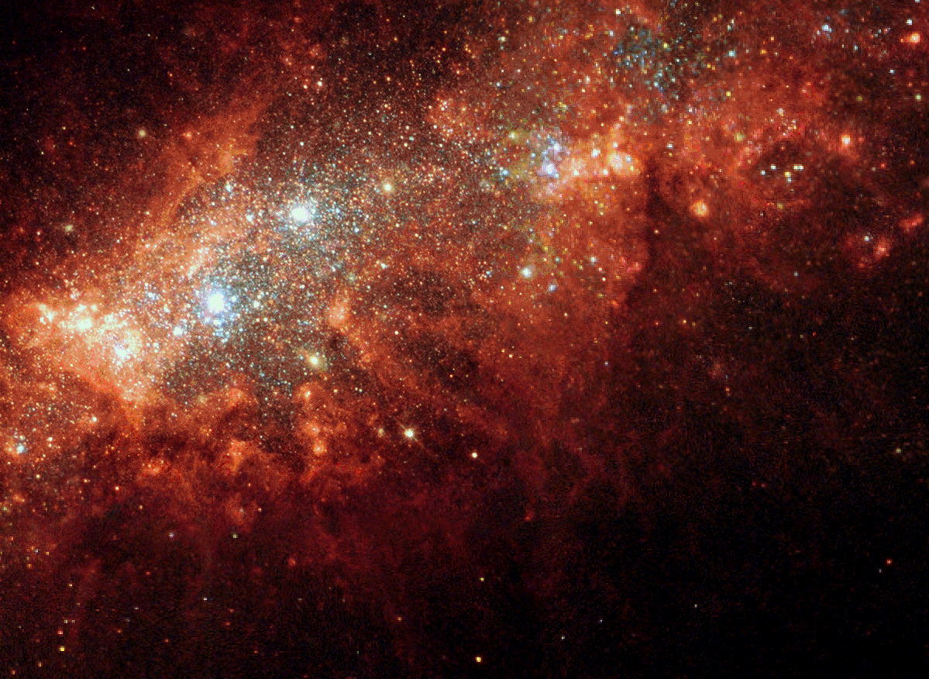
GENETIC DISTANCE ESTIMATION

Slide 7
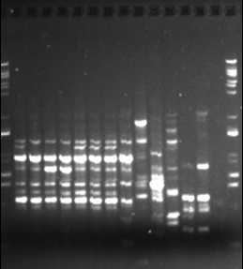
DISTANCE FROM THE FINGERPRINTS
RAPD/RFLP
Koeficient by Nei a Li 1979, PNAS 76, 1979
For each pair (x, y) count all fragments (M_{x}, M_{y}) and the fragments common to both fingerprints ( M_{xy}).
Calculate the identity as the fraction of common fragments I = 2M_{xy}/(M_{x} + M_{y})
and the distance as the complement D= 1- I
X Y

Slide 8
Distance FROM ALELE FREKVENCIES
Rogers distance (for alleles of the locus i in popuplations X_{A} and X_{B})
D= (0,5 Σ(x_{Ai} - x_{Bi})²)^{0,5}
Frequency of alleles in one locus
Allele | Population A | Population B
1 | 0,12 | 0,20
2 | 0,48 | 0,30
3 | 0,40 | 0,50
D= (0,5((0,12-0,20)²+(0,48-0,30)²+(0,40-0,50)²))^{0,5}= (0,5(0,0064+0,0324+0,01))^{0,5}= 0,156

Slide 9
Distance FROM ALELE FREKVENCIES
Rogers distance (for aleles of the locus i in popuplations X_{A} and X_{B})
D= (0,5 Σ(x_{Ai} - x_{Bi})²)^{0,5}
If we use more loci, the final distance is the average of distance in loci.
Probability of change between some aleles is higher than between others.
Reynolds distance (1983) or Nei distance (1972, 1978) reflect biological processes.

Slide 10
CALCULATION OF „p“ DISTANCE
p = fraction of nonidentical nukleotides between sequences of 2 taxa
p = n_{d}/n
AATGTAGGAATCGC
ACTGAAAGAATCGC
p = 3/14 = 0,21
Estimate of p from the whole genome comparison
ANI (average nucleotide identity) – average identity of all homologous regions recognised by BLASTN (Goris a kol. 2007) – boundary of bacterial species 95-96%.

Slide 11
THE FREQUENCY OF SUBTITUTIONS IS HIGHER THAN „p“
ACTGAACGTAACGC
C
T
G
C
T
T
T
C
Coincidence
Simple substitution
Reverse substitution
Multiple substitutions
K = 12, p = 3
We observe only 3 differences (p=3/14), but in reality there were twelve substitutions (D = 12/14).

Slide 12
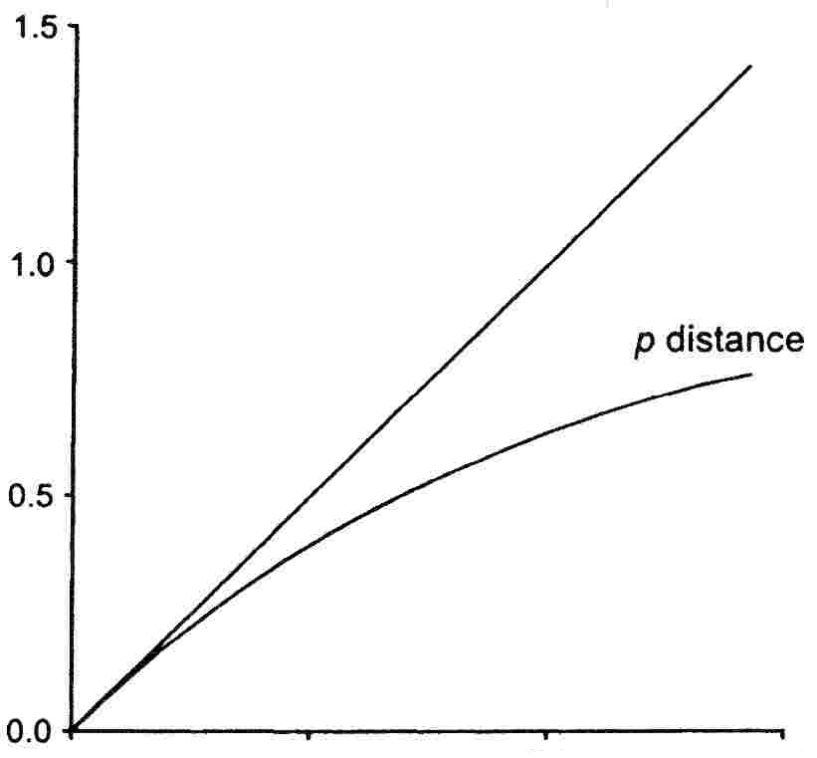
SUBSTITUTION SATURATION
Number of observed differences per position - p
0,95 PROTEINS
0,75 DNA
p
P distance is not additive
Number of substitutions per position
= D

Slide 13
BRAIN EXERCISE
Number of observed differences per position - p
0,75 DNA
p
What value the saturation will approach in case the GC content of the sequences will be 80%?
(40% G, 40% C, 10% A, 10% T)
Number of substitutions per position
1 point for everybody who solves it!

Slide 14
Poisson distribution
Distribution of occurence of rare events
100 years → 20 substitutions …………in interval 20 years, expected nr. ℷ =4
ℷ=4
ℷ=4
ℷ=4
λ – expected nr. events
k – nr. of events
Probability of no events (k=0) is
e ^{-ℷ}
ℷ⁰=1
Probability of exactly k events is: f(k,ℷ) = (ℷ^{k} e^{-ℷ})/k!
0!=1

Slide 15
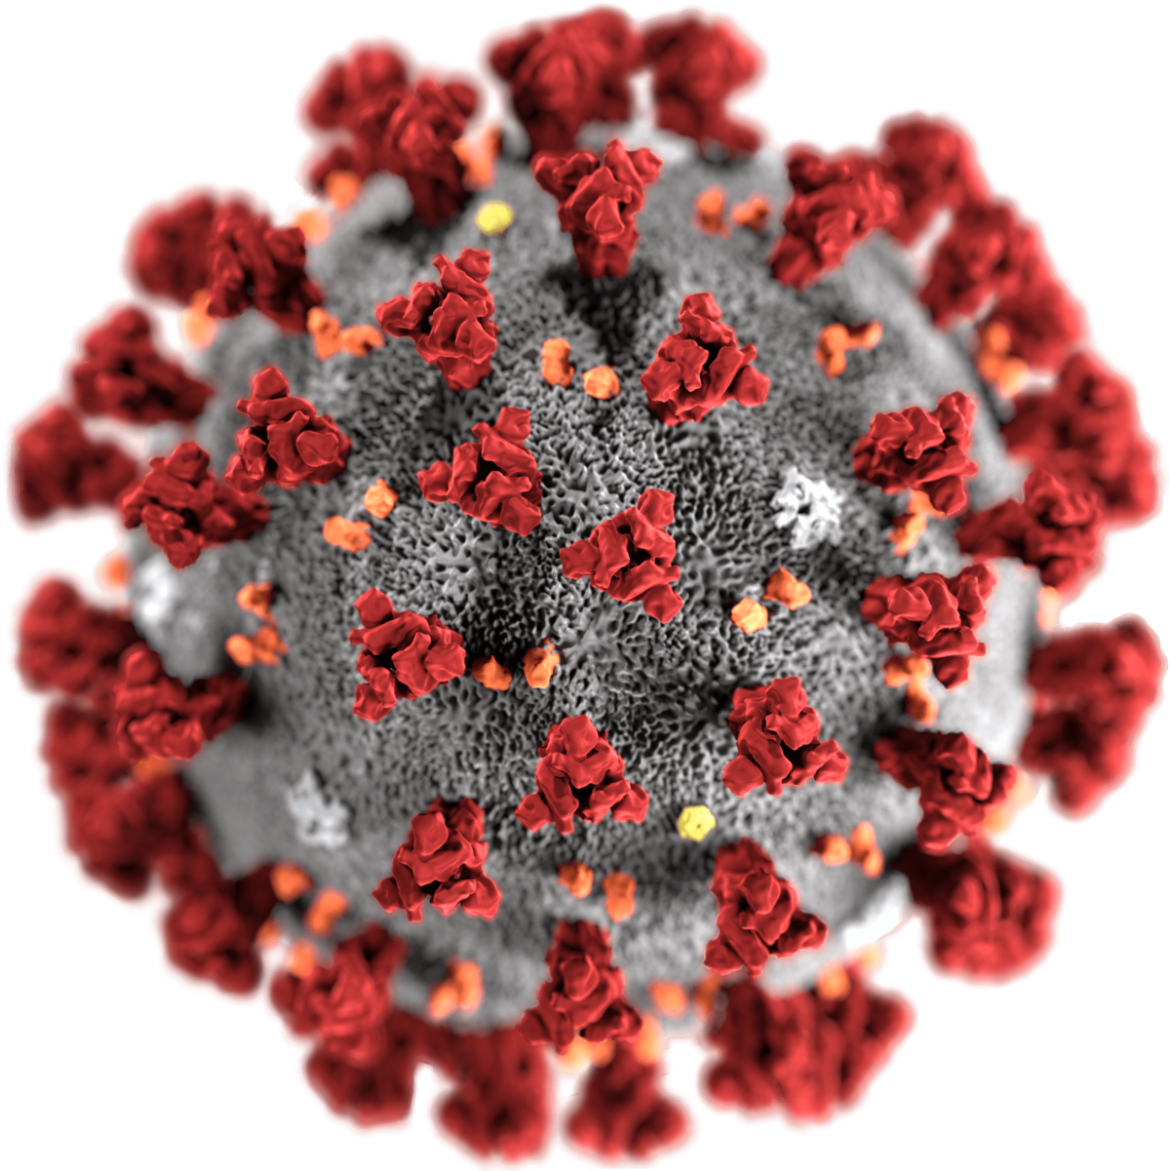
No need to take into account the saturation.
COMPULSORY ASSIGNMENT
Calculating the probability of a certain number of mutations per year
A typical SARS-CoV-2 virus accumulates only two single-letter mutations per month in its genome — a rate of change about half that of influenza and one-quarter that of HIV, says Emma Hodcroft, a molecular epidemiologist at the University of Basel, Switzerland.
Calculate the probabilities that the virus lineage accumulates exactly 48 mutations, and one mutation within a year.

Slide 16
ESTIMATE OF D
D=ut
Sequence A
Sequence B
Rate of substitutions
Time interval
Sequence A - AATGTAGGAATCGC
Sequence B - ACTGAAAGAATCGC

Slide 17
Jukes-Cantor (1961)
Corrects for multiple hits
u = substitution rate
u/3 = rate of one specific type of substitution (eg. A -> G)
A
u/3
G
u/3
u/3
Substitution rate for whatever base including itself 4/3 u
u/3
u/3
Expected nr. of substitutions in interval t 4/3 ut
T
C
u/3
u/3
We need to know the probability of substitution in t

Slide 18
Poisson distribution
Distribution of occurence of rare events
100 years → 20 substitutions …………in interval 20 years, expected nr. ℷ =4
ℷ=4
ℷ=4
ℷ=4
λ – expected nr. events
k – nr. of events
Probability of no events (k=0) is
e ^{-ℷ}
ℷ⁰=1
Probability of exactly k events is: f(k,ℷ) = (ℷ^{k} e^{-ℷ})/k!
0!=1

Slide 19
Jukes-Cantor
Corrects for multiple hits
A
u/3
G
Probability of no event in t e ^{-4/3 ut}
Probability of at least one event in t 1- e ^{-4/3 ut}
u/3
u/3
u/3
u/3
T
C
Probability of particular event in t P (C|A) = 1/4 (1- e ^{-4/3 ut})
u/3
u/3
Expected nr. of events in t 4/3 ut
Probability of change Ds = 3/4 (1- e ^{-4/3 ut})

Slide 20
Jukes-Cantor
Corrects for multiple hits
Probability of change Ds = 3/4 (1- e ^{-4/3 ut})
ut
Sequence A
Sequence B
Rate of substitutions
Time interval
Sequence A - AATGTAGGAATCGC
Sequence B - ACTGAAAGAATCGC
p, fraction of nonidentical nucleotides, is the estimate of Ds.

Slide 21
Jukes-Cantor
Corrects for multiple hits
Probability of change Ds = 3/4 (1- e ^{-4/3 ut})
A
u/3
G
u/3
u/3
Corrected nr. of substitutions D = ut = -3/4 ln(1- 4/3 p)
u/3
u/3
Variance D:
T
C
u/3
V(D) = (p(1 -p))/(L(1 - 4/3 p)²)
L= length of the sequence
u/3

Slide 22
Jukes-Cantor
example
A
u/3
G
Corrected nr. of substitutions D = ut = -3/4 ln(1- 4/3 p)
u/3
u/3
Example from our sequences:
D= -3/4 ln(1- 4/3 * 0,21)
D= 0,246
u/3
u/3
T
C
u/3
u/3

Slide 23
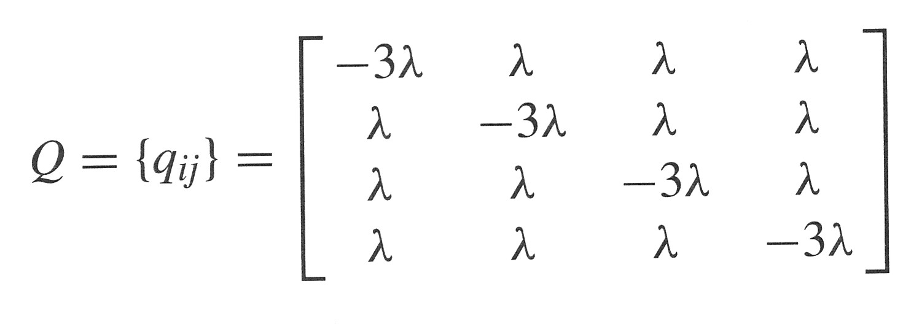
Jukes-Cantor
General derivation of the formulas
MATRICES – Q (transition rate matrix), P (transition probability matrix)
A
G
C
T
-u
u/3
u/3
u/3
A
u/3
-u
u/3
u/3
G
u/3
u/3
-u
u/3
C
u/3
u/3
u/3
-u
T
^{4/3 ut}
^{4/3 ut}
Probability of particular event in t P (C|A) = 1/4 (1- e ^{-4/3 ut})

Slide 24
Jukes-Cantor
Sum of row in P is 1
A
G
C
T
-u
u/3
u/3
u/3
A
Sum = 0
u/3
-u
u/3
u/3
G
u/3
u/3
-u
u/3
C
u/3
u/3
u/3
-u
T
^{4/3 ut}
^{4/3 ut}

Slide 25
Jukes-Cantor
Sum of row in P is 1
A
G
C
T
-u
u/3
u/3
u/3
A
u/3
-u
u/3
u/3
G
u/3
u/3
-u
u/3
C
u/3
u/3
u/3
-u
T
Sum = 1
^{4/3 ut}
^{4/3 ut}

Slide 26
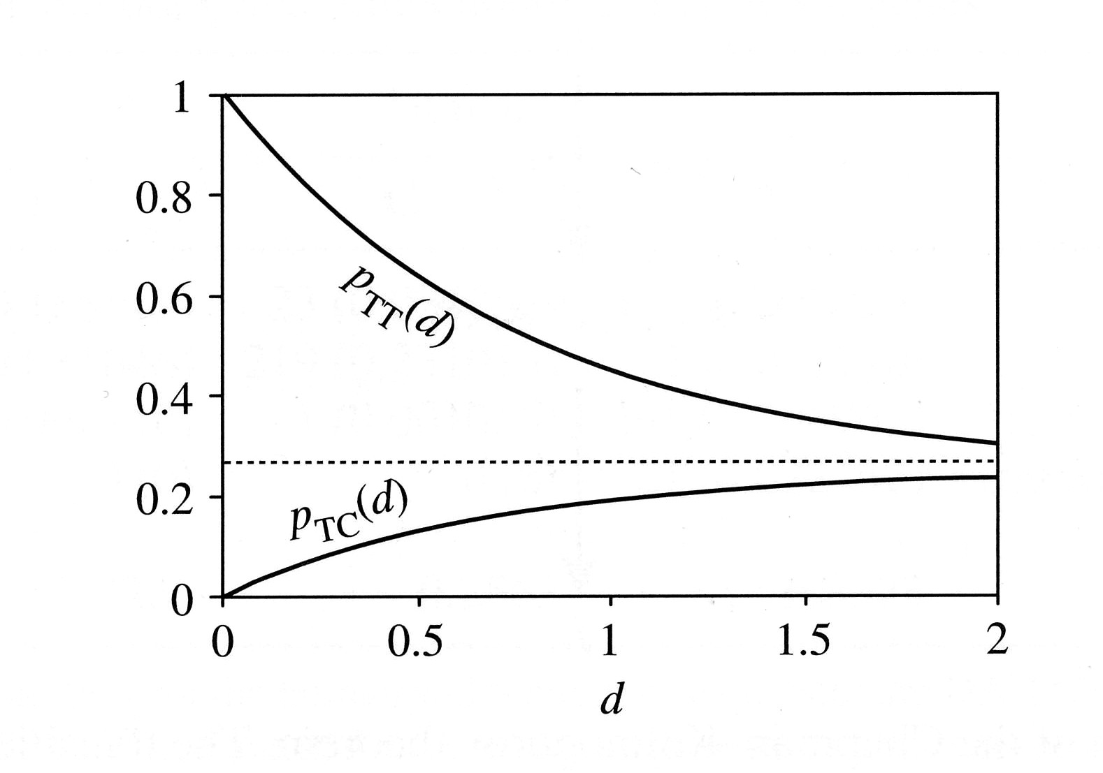
Jukes-Cantor
Infinitely distant sequences are ¼ identical
ut=∞
Sekvence A
Sekvence B
^{4/3 ut}
^{4/3 ut}
Number of observed differences per position – p
0,75 DNA
p
Number of substitutions per position

Slide 27
Jukes-Cantor
is symmetrical
A
G
C
T
-u
u/3
u/3
u/3
A
u/3
-u
u/3
u/3
G
u/3
u/3
-u
u/3
C
u/3
u/3
u/3
-u
T
Sekvence A
Sekvence B

Slide 28
Jukes-Cantor
is symmetrical
A
G
C
T
-u
u/3
u/3
u/3
A
u/3
-u
u/3
u/3
G
u/3
u/3
-u
u/3
C
u/3
u/3
u/3
-u
T
Sekvence A
Sekvence B

Slide 29
OTHER MODELS
A
α
G
Kimura 2P
Kimura 2 parameter
β
β
β
β
T
C
α

Slide 30
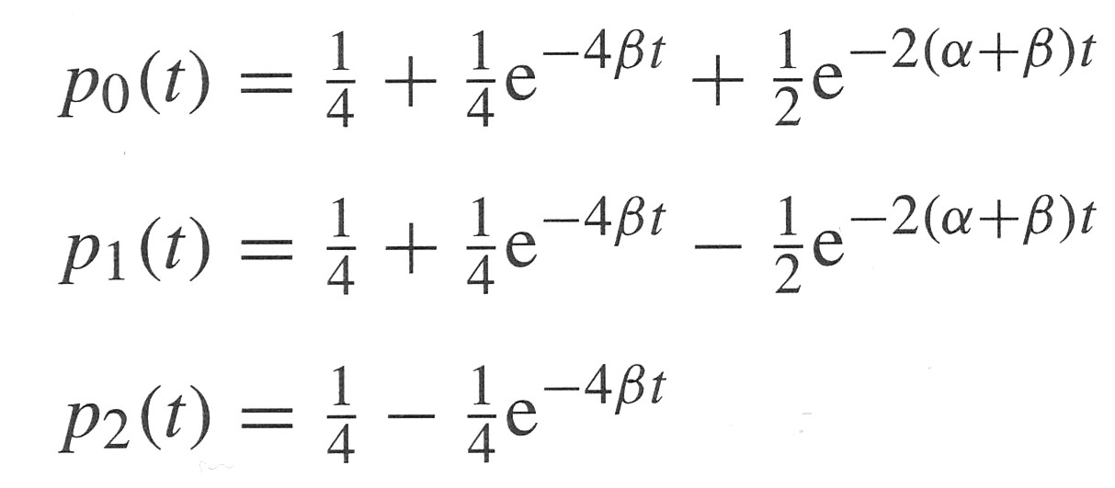
OTHER MODELS
A
α
G
Kimura 2P
Kimura 2 parameter
β
β
β
β
T
C
α

Slide 31
OTHER MODELS
Kimura 2P
Kimura 2 parameter
A
α
G
D = 0,5 ln(a) + 1/4 ln(b)
a = 1/(1 - 2P - Q) b = 1/(1 -2Q)
β
β
β
β
P – fraction of transitions
Q – fraction of transversions
Variance D:
T
C
α
V(D) = [a²P + c²Q -(aP +cQ)²]/L c = (a + b)/2
L= length of sequence

Slide 32
OTHER MODELS
Kimura 2P
Kimura 2 parameter
A
α
G
D = 0,5 ln(a) + 1/4 ln(b)
a = 1/(1 - 2P - Q) b = 1/(1 -2Q)
β
β
β
β
Example of our sequence:
P=2/14=0,14
Q=1/14=0,07
a = 1/(1 – 2*0,14 – 0,07) = 1,54
b = 1/(1 -2*0,07) = 1,16
D = 0,5 ln(1,54) + 1/4ln(1,16)=0,254
T
C
α

