Slide 1
MEASURES OF SEQUENCE DIVERGENCE
Sequence A - AATGTAGGAATCGC
Sequence B - ACTGAAAGAATCGC
p = 3/14….. p is not additive
Good measure is the nr. of substitutions…. D
D = ut
Sequence A
Sequence B

Slide 2
Poisson distribution
Distribution of occurence of rare events
λ – expected nr. events
k – nr. of events
Probability of exactly k events is: f(k,ℷ) = (ℷ^{k} e^{-ℷ})/k!
COMPULSORY ASSIGNMENT
Expected nr. of mutations in corona virus in one year ℷ = 24
Probability of exactly 48 events is: f(48,24) = (24⁴⁸ e⁻²⁴)/48!= 5.41*10⁻⁶
Probability of exactly 0 events is: f(1,24) = (24¹ e⁻²⁴)/1!= 9.06*10⁻¹⁰

Slide 3
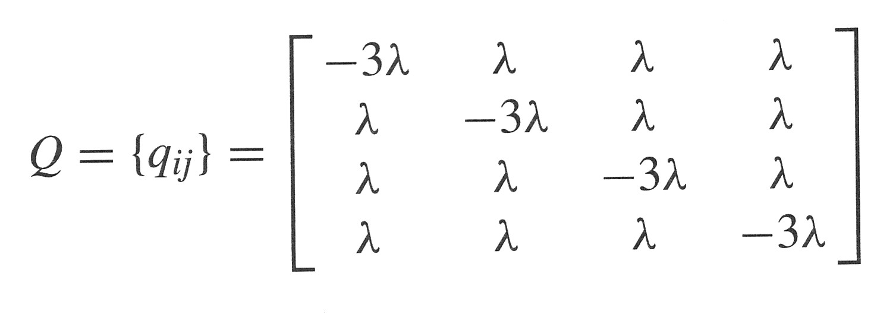
MATRICES
Substitution rate matrix
T
C
A
G
-u
u/3
u/3
u/3
T
u/3
-u
u/3
u/3
C
u/3
u/3
-u
u/3
A
u/3
u/3
u/3
-u
G
Transition probability matrix
^{4/3 ut}
^{4/3 ut}
P(t) = e^{Qt}

Slide 4
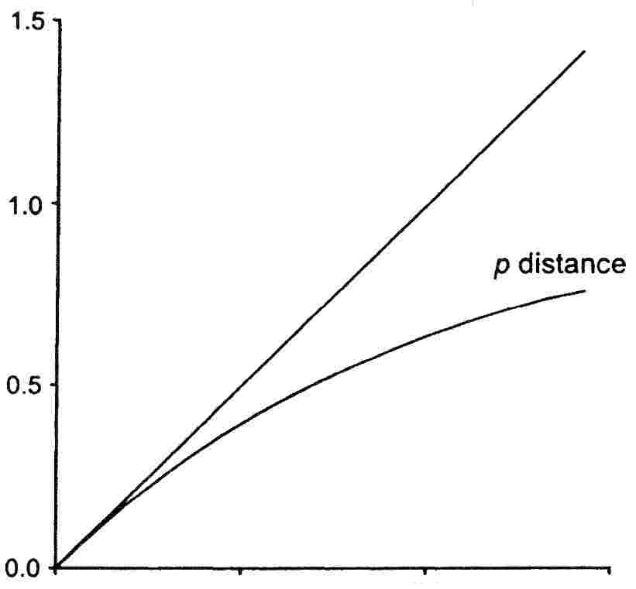
SUBSTITUTION SATURATION
Number of observed differences per position - p
0,75 DNA
p
Number of substitutions per position

Slide 5
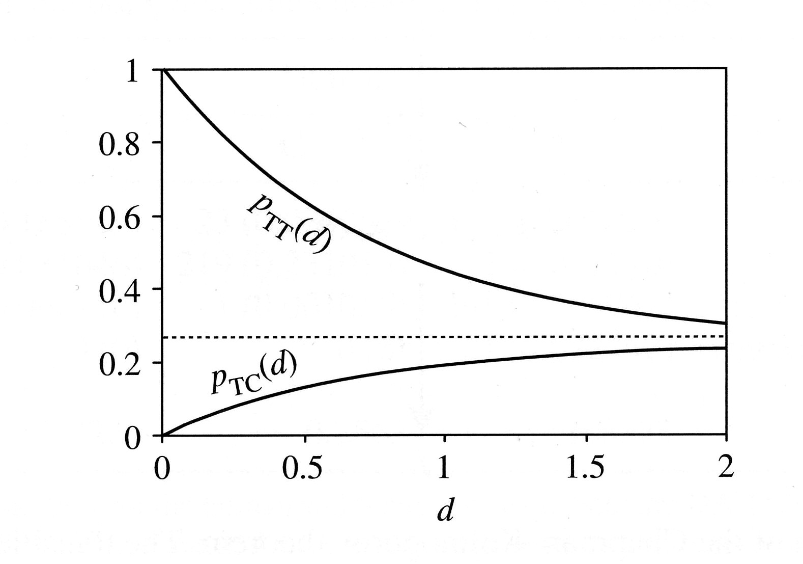
Jukes-Cantor
Infinitely distant sequences are ¼ identical
ut=∞
Sekvence A
Sekvence B
^{4/3 ut}
^{4/3 ut}
Number of observed differences per position – p
0,75 DNA
p
Number of substitutions per position

Slide 6
BRAIN EXERCISE
40 40 10 10
G
C
A
T
Probability of identical nucleotide in the other sequence:
0.40 0.40 0.10 0.10
40*0.40=16
40*0.40=16
10*0.1=1
10*0.1=1
16 + 16 + 1 + 1 = 34
100 – 34 = 66, 66/100 …. Average divergence of unrelated sequences
In general:
0.4*0.4 + 0.4*0.4 + 0.1*0.1 + 0.1*0.1 = 0.34

Slide 7
NUCLEOTIDE FREQUENCIES
F84
Equlibrium nucleotide frequencies
π_{A} π_{C} π_{G} π_{T}
T
C
A
G
T
C
A
G

Slide 8
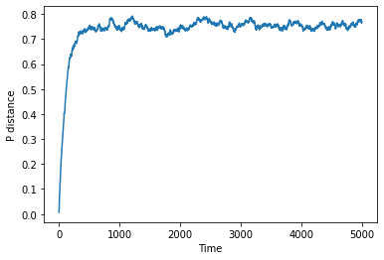
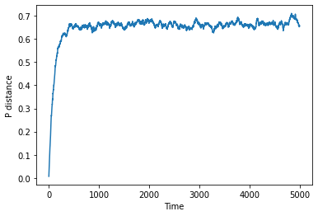
NUCLEOTIDE FREQUENCIES
40 40 10 10
G
C
A
T
Probabilities of all changes = 0,25
Probability X G, C = 0,4
Probability X A, T = 0,1
By Anna Agafonová

Slide 9
OTHER MODELS
GTR
General time reversible
+
A
ζ
G
Equilibrium nucleotide frequencies
π_{A} π_{C} π_{G} π_{T}
β
ε
γ
δ
Parameters: frequence (rate) of change (αβγδεζ) and nucleotide frequences (π_{A} π_{C} π_{G} π_{T}) are estimated from the analysed sequences.
T
C
α

Slide 10
LogDet distance
d_{xy} = -ln (det F_{xy})
Sequence A
Sekvence B
Alignment of 900 positions
F_{xy} =[ ]
0,249 0,006 0,027 0,009
0,003 0,166 0,001 0,018
0,027 0,006 0,256 0,004
0,006 0,021 0,009 0,194
d_{xy} = -ln (det F_{xy}) = -ln (0.002) = 6,216

Slide 11
MODEL ASSUMPTIONS
Marcov property – events are not affected by the past.
Rate homogeneity (in time) – rate are constant in time (opposite is „heterotachy“)
Rate homogeneity (in place) – are are constant across sites (opposite is „rate heterogeneity across sites“)
Stationarity – base frequencies are in the same equlibrium.

Slide 12
WHICH DISTANCES TO USE?
Multi-parameter models (GTR) are more flexible and usually more accurate than simple methods. However, they need a large number of parameters, which needs to be estimated, and the distances calculated by them have a larger variance. Therefore, they give worse results for shorter allignments.
Multiparametric distances
Sequence divergence
Simple distamces
Alignment length

Slide 13
PROTEIN DISTANCES
Poisson model:
D = -19/20 ln(1- 20/19 p)
p – fraction of different proteins
Analogy of Jukes-Cantor model
Assumes identical rates for all types of changes
D = -3/4 ln(1- 4/3 p)

Slide 14
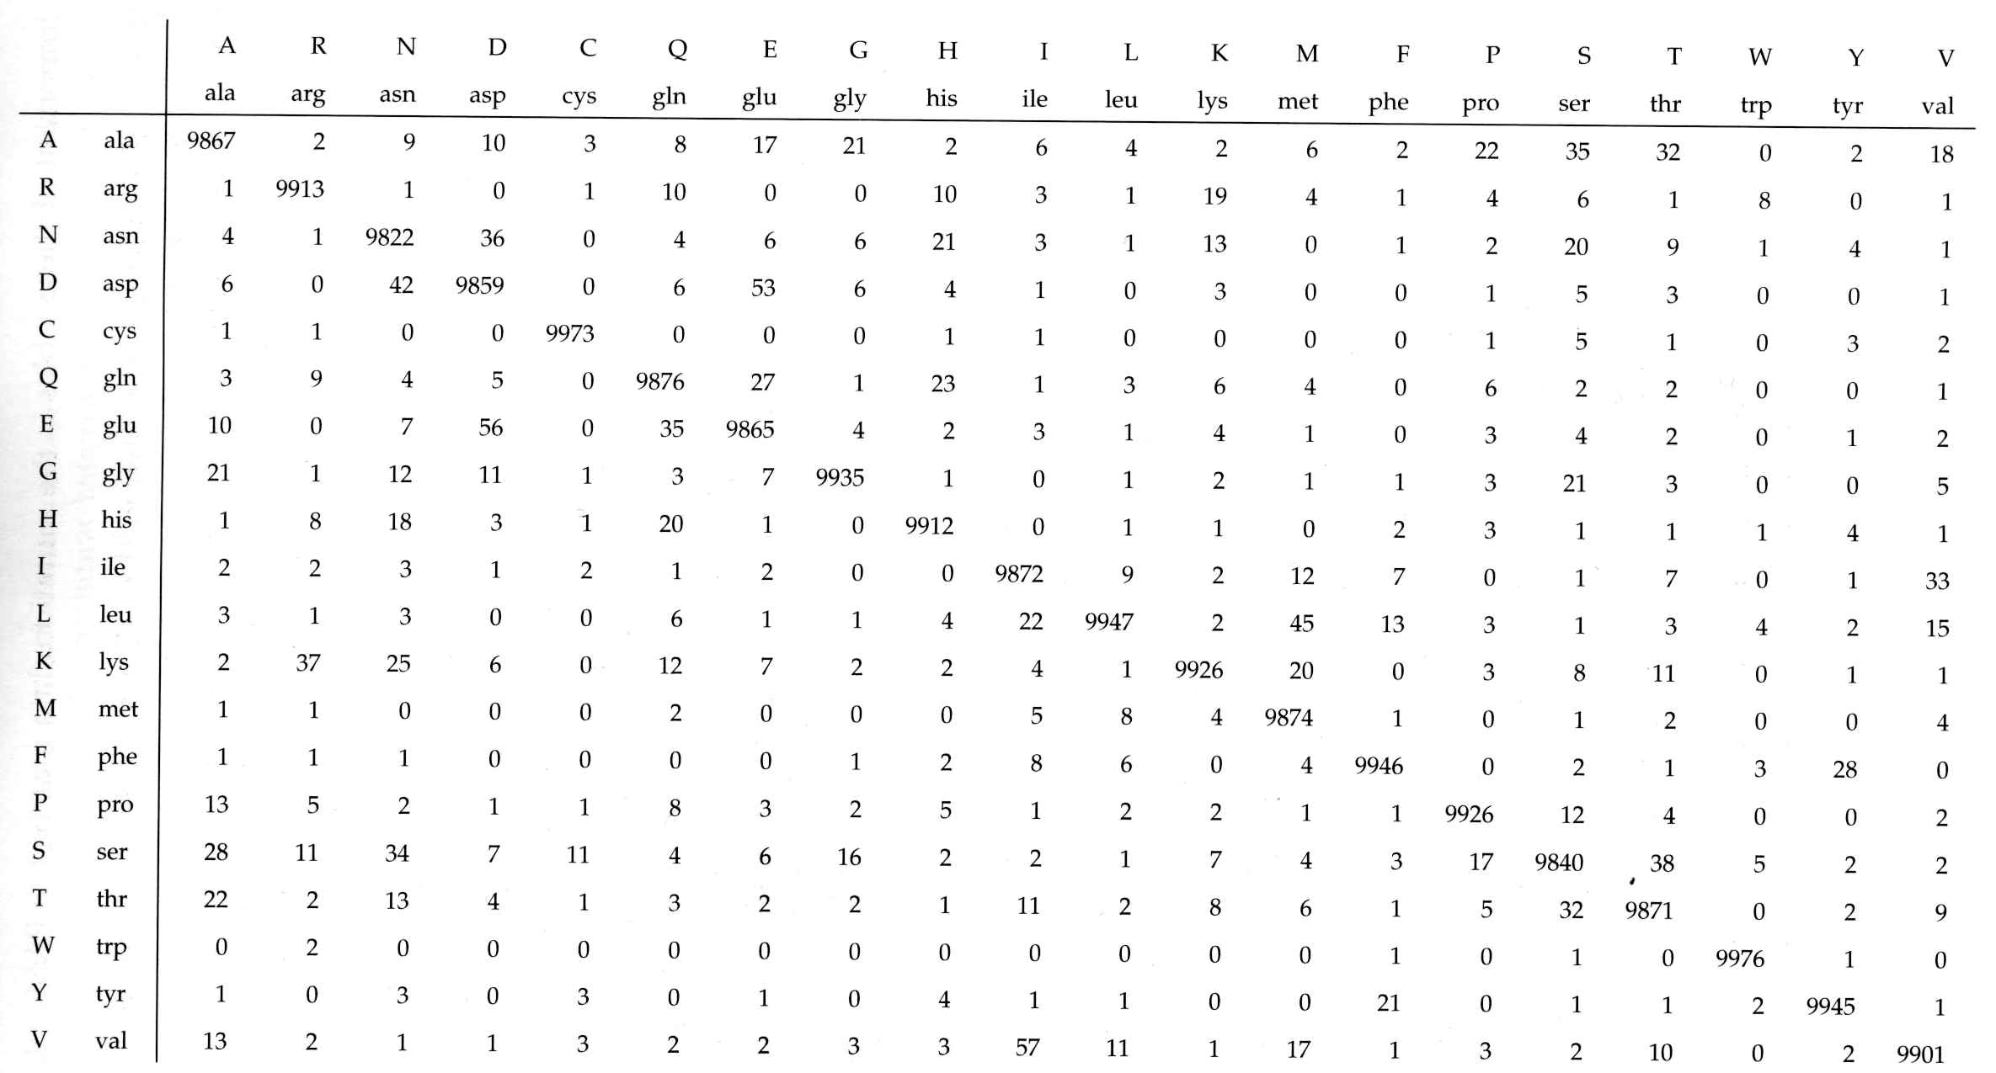
EMPIRICAL PROTEIN MODELS
PAM 001 – differences between protein sequences across branch of D=0,01.
P=e^{0,01Q}

Slide 15
EMPIRICAL PROTEIN MODELS
PAM 001 – differences between protein sequences across branch of D=0,01.
Matrix can be recalculated for different D by exponentiation, e.g. D=0,1 ~ M¹⁰ (PAM10)
P=e^{DQ}
P^{x} =e^{xDQ}
P^{x} =(e^{DQ})^{x}

Slide 16
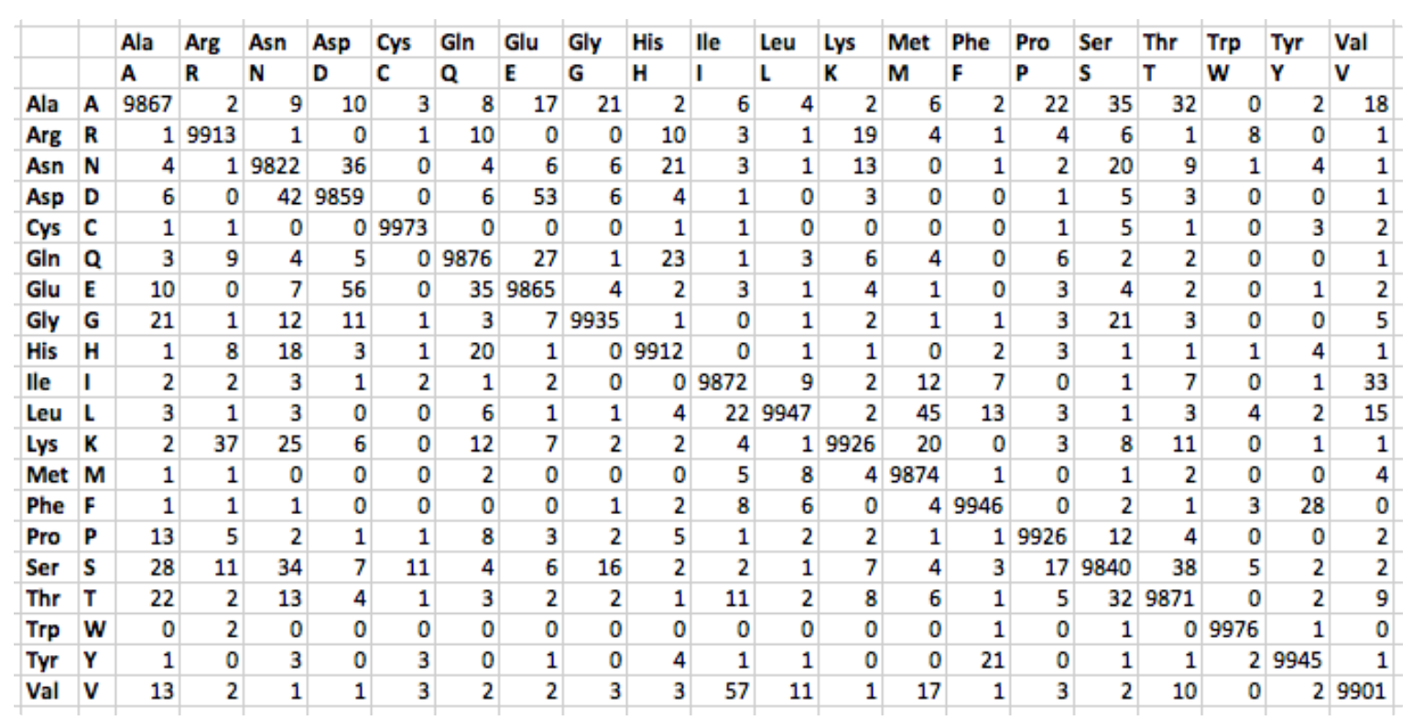
PAM 001 for 10 000 amino acids

Slide 17
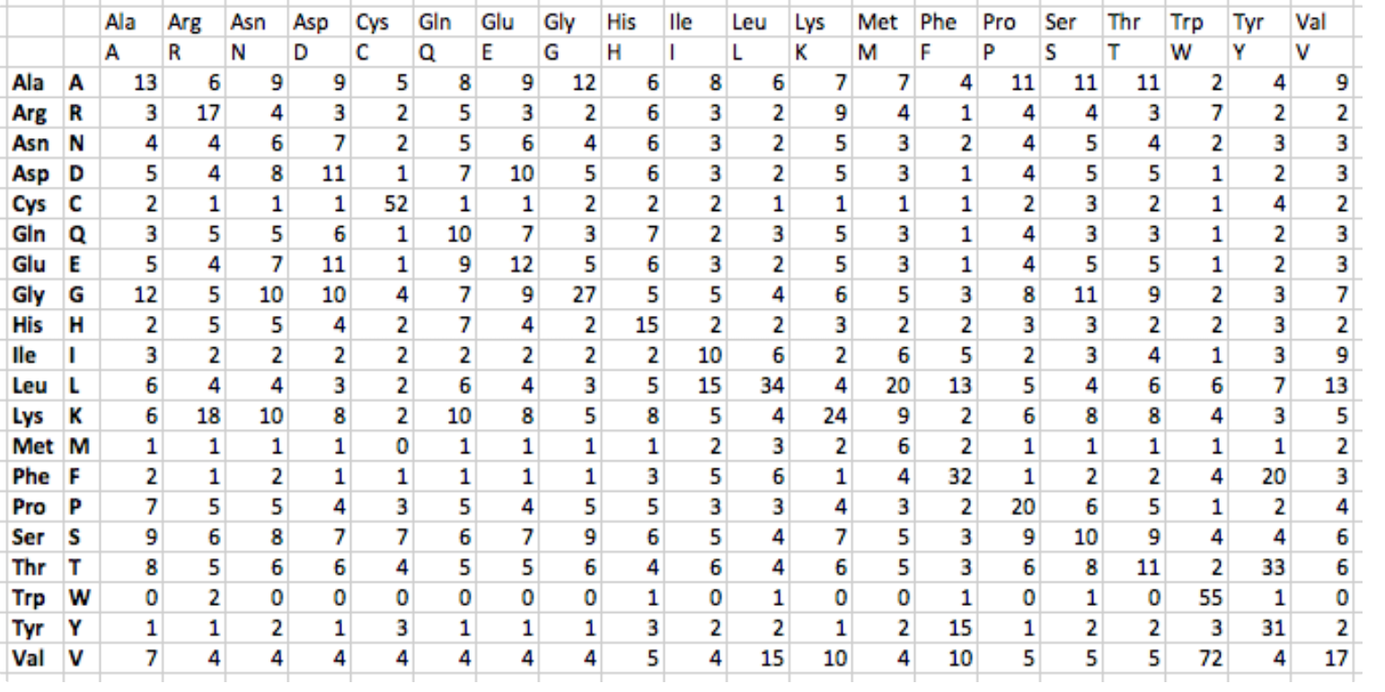
PAM 250 = (PAM 001)²⁵⁰ for 100 amino acids

Slide 18
EMPIRICAL PROTEIN MODELS
Better substituion matrices (Q) derived from real proteins
LG (LG-F)
WAG (WAG-F)
JTT (JTT-F)
mtREV (mtREV-F)

Slide 19
WHY DIFFERENT APPROACHES?
DNA – parameters derived from our alignment
Proteiny – matrices (parameters) derived from larger sets of proteins
Sequence A
Sequence B

Slide 20
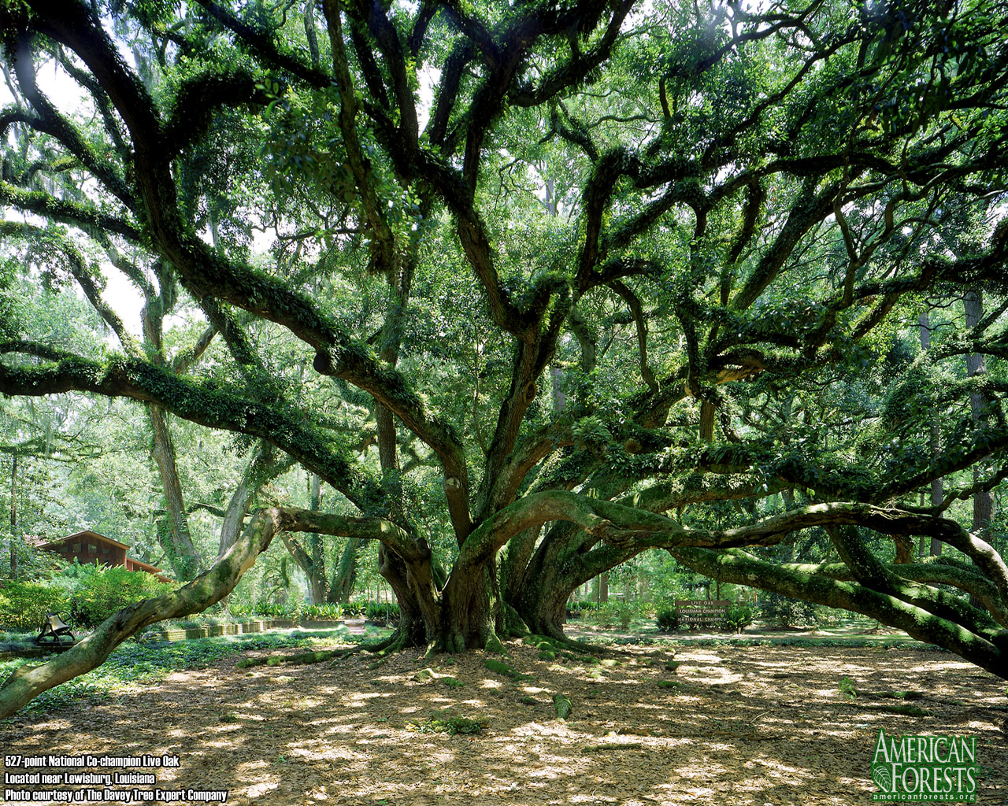
PHYLOGENETIC TREES

Slide 21
ANATOMY OF A TREE
Inner branch
Terminal branch
Inner node
(last common ancestor)
Terminal node, leaf (present)
A
B
C
D
E
F

Slide 22
ROOTED AND UNROOTED TREE
F
A
E
D
B
C
A
B
C
D
E
F

Slide 23
VARIOUS FORMS OF DRAWING TREES
B
C
C
D
B
A
A
D
D
A
C
B

Slide 24
WHAT WE NEED TO FIND OUT
Co chceme u stromu zjistit?
Shape (topology)
Branch lengths
Robustness of the topology
Where is the root
A
B
C
D
E
F

Slide 25
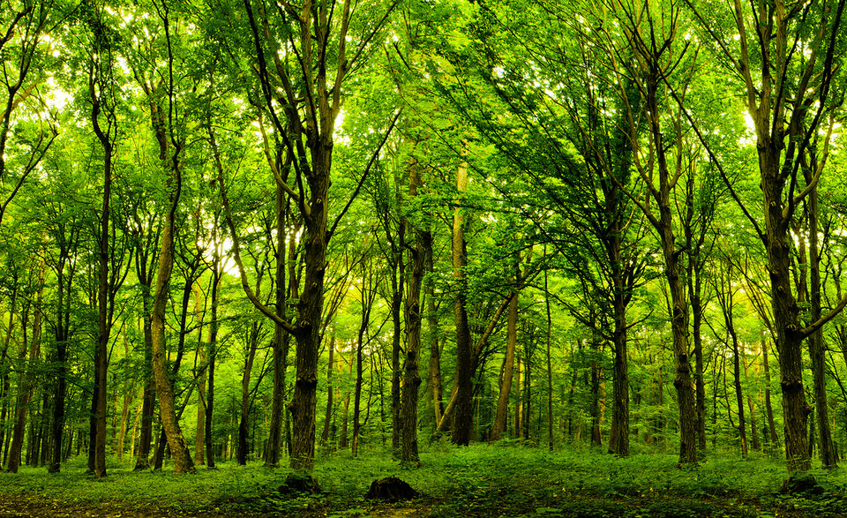
HOW TO FIND THE BEST TREE?

Slide 26
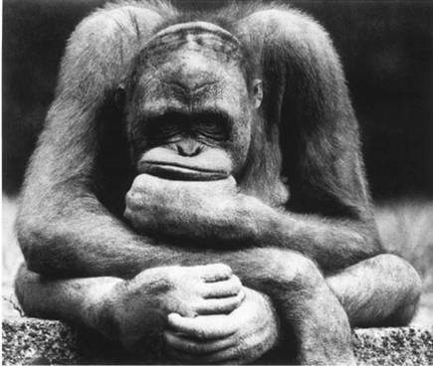
HOW TO RECOGNIZE THE BEST TREE?
Tree, which best explains our data.
Algorithm – finds only one tree by sequential addition of sequences, UPGMA clustering analysis, Neighbor-joining (distance methods).
Search of tree space – heuristic search, Marcov chain Monte Carlo – and scoring trees on the way according to various criteria.

Slide 27
STARTING WITH DISTANCE MATRIX
A-B are taxa or OTU (operation taxonomic units)
 | A | B | C | D
A | -
B | 0.5 | -
C | 0.45 | 0.15 | -
D | 0.55 | 0.4 | 0.35 | -
Simples algorithmic method is clustering analysis UPGMA
(Unweighted Pair Group Method with Arithmetic mean)

Slide 28
UPGMA
1) Find in the matrix the shortest distance (in this case d_{BC})
 | A | B | C | D
A | -
B | 0.5 | -
C | 0.45 | 0.15 | -
D | 0.55 | 0.4 | 0.35 | -
2) We combine the two OTUs (species) with the smallest mutual distance into one OTU and calculate the distance of this OTU from the others:
D_{(BC)A} = (D_{AB} + D_{AC})/2 = (0,5 + 0,45)/2 = 0,475
D_{(BC)D} = (D_{BD} + D_{CD})/2 = (0,4 + 0,35)/2 = 0,375
(in general: the arithmetic mean of the distances of all pairs of simple OTUs (species), where each member of the pair comes from one of the connected OTUs)
B
C

Slide 29
UPGMA
3) We create new smaller matrix with recalculated distances.
 | A | BC | D
A | -
BC | 0.475 | -
D | 0.55 | 0.375 | -
4) We repeat the whole procedure. The smallest distance this time is between D and BC. Therefore, we connect D to BC. We calculate the distance BCD from A. D_{(BCD)A} = (D_{AB} + D_{AC} + D_{AD})/3 =
(0,5 + 0,45 + 0,55)/3 = 0,5
B
C
D
A

Slide 30
UPGMA
Calculation of branchlengths:
D_{BC} = 0,15
D_{(BC)D} = 0,375
D_{(BCD)A} = 0,5
D_{BC}/2
B
D_{(BC)D}/2 - D_{BC}/2
D_{BC}/2
C
D_{(BCD)A}/2 - D_{(BC)D}/2
D_{(BC)D}/2
D
D_{(BCD)A}/2
A

Slide 31
UPGMA
Calculation of branchlengths:
D_{BC} = 0,15
D_{(BC)D} = 0,375
D_{(BCD)A} = 0,5
0,075
B
D_{(BC)D}/2 - D_{BC}/2
0,075
C
D_{(BCD)A}/2 - D_{(BC)D}/2
D_{(BC)D}/2
D
D_{(BCD)A}/2
A

Slide 32
UPGMA
Calculation of branchlengths:
D_{BC} = 0,15
D_{(BC)D} = 0,375
D_{(BCD)A} = 0,5
0,075
B
0,1125
0,075
C
D_{(BCD)A}/2 - D_{(BC)D}/2
0,1875
D
D_{(BCD)A}/2
A

Slide 33
UPGMA
Calculation of branchlengths:
D_{BC} = 0,15
D_{(BC)D} = 0,375
D_{(BCD)A} = 0,5
0,075
B
0,1125
0,075
C
0,0625
0,1875
D
0,25
A

Slide 34
UPGMA
It is the simplest method of constructing phylogenetic trees, the tree can take root
It assumes that the substitution rate is constant, so the distance (D) is directly proportional to the time (T), the molecular clock holds exactly
Therefore, it assumes that the distance and the tree is ultrameric, all today's taxa have "substituted" equally far
B
C
D
A

Slide 35
UPGMA
However, these assumptions are almost always violated
If the assumptions are violated significantly, the method will simply confuse and give a wrong tree
It tends to move more divergent sequences closer to the root of the tree - the artifact of attracting long branches (LBA)
LBA is one of the biggest pitfalls of molecular phylogenetics

Slide 36
UPGMA
0,2
B
0,1
 | A | B | C | D
A | -
B | 0,8 | -
C | 0,9 | 0,5 | -
D | 0,6 | 0,4 | 0,5 | -
0,3
C
0,1
0,1
D
0,4
A

Slide 37
UPGMA
0,2
0,2
B
B
0,1
0,05
0,3
C
0,2
0,1
0,13
D
0,1
D
0,25
C
0,4
A
0,383
A

Slide 38
LEAST SQUARES
1. We have matrix of genetic distances
A
B
 | A | B | C | D
A | -
B | 0.5 | -
C | 0.45 | 0.15 | -
D | 0.55 | 0.4 | 0.35 | -
A
C
A
D
B
C
B
D
C
D

Slide 39
LEAST SQUARES
A
B
2. Let's take the first topology and test how well the distances fit into it. We change the lengths of the branches to fit as well as possible. We will remember the best score.
A
C
A
D
B
C
B
D
C
D
A
C
D
B
n n
Q = ∑ ∑w_{ij} (D_{ij} - d_{ij})²
i=1 j=1
Score

Slide 40
LEAST SQUARES
3. We take another topology and calculate the score.
A
B
A
C
A
D
4. We go through all possible topologies. We will choose the one with the best score overall.
B
C
B
D
C
D
A
B
D
n n
C
Q = ∑ ∑w_{ij} (D_{ij} - d_{ij})²
i=1 j=1
Score

Slide 41
LEAST SQUARES
1
0,2
2
0,2
B
B
0,1
0,05
 | A | B | C | D
A | -
B | 0,8 | -
C | 0,9 | 0,5 | -
D | 0,6 | 0,4 | 0,5 | -
0,1
0,3
C
0,2
0,13
D
0,1
D
0,25
C
0,4
A
0,383
A
CALCULATE AS COMPULSORY ASSIGNMENT
Q₁=
Q₂=
The least squares guarantee finding the correct tree if the distances are calculated correctly.

Slide 42
MINIMUM EVOLUTION
We optimize the lengths of branches on topologies in exactly the same way as in the case of "least squares", but we score according to the sum of the lengths of all branches.
n n
Q = ∑ ∑ D_{ij}
i=1 j=1
D_{ij}…………………braches on the tree i, j…………………nodes of the tree
We choose the one with shortest sum of branchlengths.

Slide 43
MINIMUM EVOLUTION
1
0,2
2
0,2
B
B
0,1
0,05
0,3
n n
0,1
C
0,13
0,2
D
Q = ∑ ∑ D_{ij}
0,1
D
0,25
C
i=1 j=1
0,4
A
0,383
A
CALCULATE AS COMPULSORY ASSIGNMENT
Q₁=
Q₂=

Slide 44
NEIGHBOR-JOINING
Algorithmized "minimum evolution" we gradually decompose the star tree (star decomposition) by clustering the nearest taxa so that in each step the total length of the tree is reduced as much as possible.

Slide 45
BRAIN EXERCISE
Construct the tree from the distance matrix below using UPGMA
Is the substitution rate in this dataset constant and if not which taxon deviates?
 | A | B | C | D | E | F
A | -
B | 0,3 | -
C | 0,62 | 0,52 | -
D | 0,62 | 0,52 | 0,36 | -
E | 0,62 | 0,52 | 0,36 | 0,3 | -
F | 0,62 | 0,52 | 0,36 | 0,3 | 0,1 | -

