Slide 1
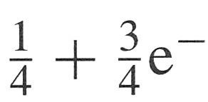
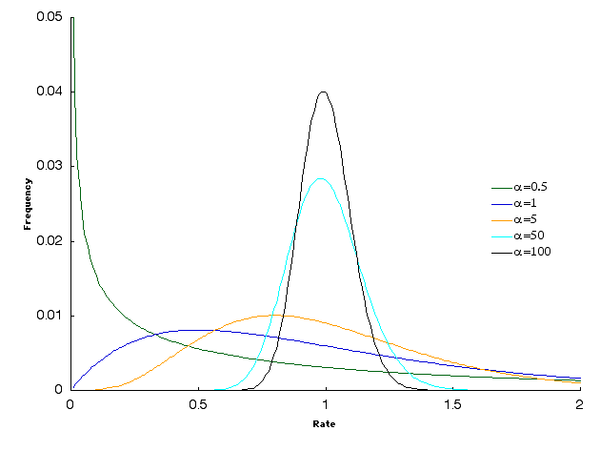
t
A
B
Sequence A
Sequence B
8/10
2/10
r₁=10/8
r₂=0
0.8r₁ + 0.2r₂ = 1
2/10( ) + 8/10( )
P_{o}(t) =
0t
10t/8
2/10 + 8/10( ) = 2/5 + 3/5e^{-5t/4}
P_{o}(t) =
10t/8
P(t) = 1/4 e^{0,0334Qt} + 1/4 e^{0,2519Qt}
+ 1/4 e^{0,8203Qt} + 1/4 e^{2,8994Qt}

Slide 2
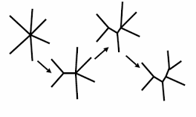
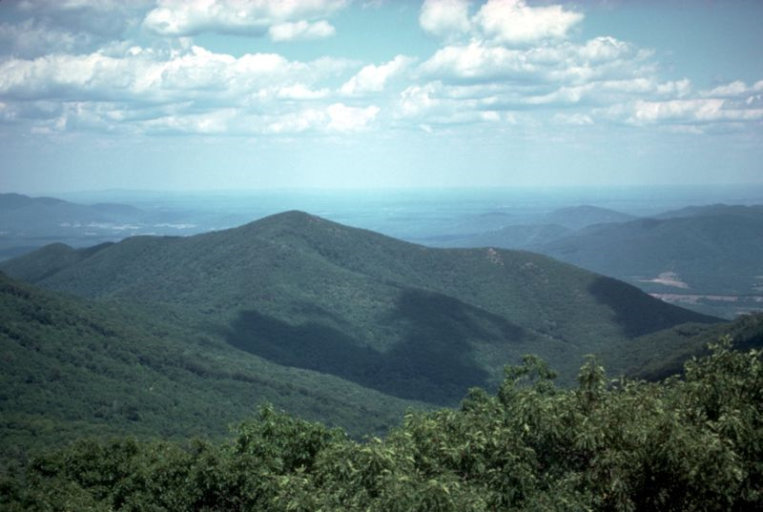
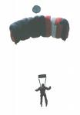
Algorithm
A
B
A
C
A
D
B
C
B
D
C
D
Scoring trees in their space
 | A | B | C | D
A | -
B | 0,8 | -
C | 0,9 | 0,5 | -
D | 0,6 | 0,4 | 0,5 | -

Slide 3
R
n | # outer branches | # inner branches | # outer branches | # inner branches
3 | 3 | 0 | 3 | 2

Slide 4
R
n | # outer branches | # inner branches | # outer branches | # inner branches
3 | 3 | 0 | 3 | 2
4 | 4 | 1 | 4 | 3
5 | 5 | 2 | 5 | 4
6 | 6 | 3 | 6 | 5
7 | 7 | 4 | 7 | 6
n | n | n-3 | n | n-1
2n-3
2n-1
Trees with n taxa were created from a tree with n-1 taxa by attaching the new branch to any of its 2(n-1)-3=2n-5 and 2(n-1)-1=2n-3 branches for unrooted and rooted trees respectively.
In each step the number of trees grew by 2n-5 or 2n-3 factor (odd numbers) from 2n-5 or 2n-3 down to 1 = > (2n-5)!! or (2n-3)!!

Slide 5



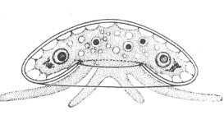
MAXIMUM PARSIMONY
ACCTGGATGC
ACTTGAATGC
ACTTCGATGG
ACTTCAAGGG
7
3
4
1
0
5
5
0
6
8
1
3
4
5
6
2
1
0

Slide 6
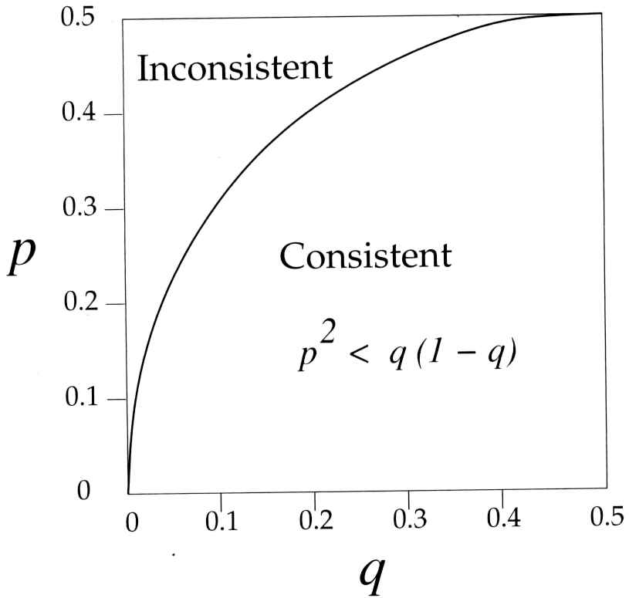
LONG BRANCH ATTRACTION
Maximum parsimony is inconsistent estimator
A
p
B
q
q
q
A
C
p
D
C
p
p
q
A
C
q
q
p
p
B
D
q
q
q
B
D

Slide 7
LIKELIHOOD PRINCIPLE
We would like to know the probability of hypothesis (tree) given the data (alignment) we observe.
P (Hypothesis|Data) = P(H|D)
Bayes theorem states P(H|D) = P(H) * P (D|H) / P(D)
P (D|H) …… is a likelihood of hypothesis (probability of data given the hypothesis – if the hypothesis was true)
Hmm, strange…. could you give us and example

Slide 8


PROBABILITY OF BEING POSITIVE
What is the probability for patient being positive given the positive test.
Antigenic COVID test:
Sensitivity (probability of positive test in positive patient) 80%
Specificity (probability of negative test in negative patient) 99,2%
Prevalence of the dissease in population 1%
P(H) * P (D|H)
P(H|D) =
P(D)

Slide 9




PROBABILITY OF BEING POSITIVE
What us the probability for patient being positive given the positive test.
Antigenic COVID test:
Sensitivity (probability of positive test in positive patient) 80%
Specificity (probability of negative test in negative patient) 99,2%
Prevalence of the dissease in population 1%
P(+)*P (+test|+)
P(+|+test) =
P(+)*P (+test|+) + P(-)*P (+test|-)

Slide 10
PROBABILITY OF BEING POSITIVE
What us the probability for patient being positive given the positive test.
Antigenic COVID test:
Sensitivity (probability of positive test in positive patient) 80%
Specificity (probability of negative test in negative patient) 99,2%
Prevalence of the dissease in population 1%
0.01 * 0.8
0.502 =
0.01 * 0.8 + 0.99 * 0.008
Compulsory assignment:
Calculate the probability for patient being negative given the negative test.

Slide 11
PHYLOGENY
DATA
ACCTGGATGC...
ACTTGAATGC…
ACTTCGATGG…
ACTTCAAGGG…
P(H) * P (D|H)
P(H|D) =
P(D)
HYPOTHESIS
Evolutionary model:
Relative substitution rates
Frequencies of residues
Rate heterogeneity ...
Topology

Slide 12

HOW TO CALCULATE LIKELIHOODS
Coin toss
Hypothesis…probability of head (h=0,4)
Now we need the data:
HHEEHEHHEEE
Calculating likelihood….
Probability of event A and B
P_{A&B} = P_{A} * P_{B}
Probability of even A or B
P_{A nebo B} = P_{A} + P_{B}

Slide 13
HOW TO CALCULATE LIKELIHOODS
Coin toss
Hypothesis…probability of head (h=0,4)
Now we need the data:
HHEEHEHHEEE
Calculating likelihood….
Probability of event A and B
P_{A&B} = P_{A} * P_{B}
Probability of even A or B
P_{A nebo B} = P_{A} + P_{B}

Slide 14
PHYLOGENY
DATA
HYPOTHESIS
Taxon A CCCTGG
Taxon B ACTTGA
Evolutionary model:
Distance (branch length)
t
A
B
L = P(A|C,t)

Slide 15
PHYLOGENY
DATA
HYPOTHESIS
Taxon A CCCTGG
Taxon B ACTTGA
Evolutionary model:
Distance (branch length)
t
A
B
L = P(A|C,t) * P(C|C,t)

Slide 16
PHYLOGENY
DATA
HYPOTHESIS
Taxon A CCCTGG
Taxon B ACTTGA
Evolutionary model:
Distance (branch length)
t
A
B
L = P(A|C,t) * P(C|C,t) * P(T|C,t)…..

Slide 17
PHYLOGENY
DATA
HYPOTHESIS
Taxon A CCCTGG
Taxon B ACTTGA
Evolutionary model: Jukes-Cantor
P_{ii} = ¼ + ¾ e^{-4/3t}
P_{ij} = ¼ - ¼ e ^{-4/3t}
Distance (branch length)
t
A
B
L = P(A|C,t) * P(C|C,t) * P(T|C,t)…..

Slide 18
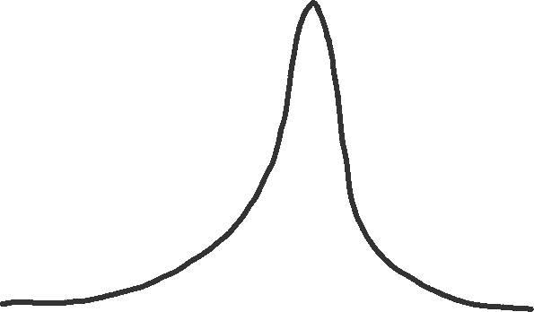
PHYLOGENY
DATA
HYPOTHESIS
Taxon A CCCTGG
Taxon B ACTTGA
Evolution model: Jukes-Cantor
Brain exercise
Calculate the approximate length of the branch for a DNA alignment of two sequences with a length of 100 positions, which differs in 15 positions. Consider the substitution model JC and use the maximum likelihood method
Distance (branch length)
t
A
B
L
0
t
0
0,68

Slide 19
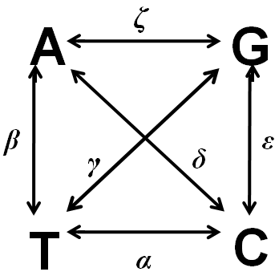
PHYLOGENY
DATA
HYPOTHESIS
Taxon A CCCTGG
Taxon B ACTTGA
Evolutionary model: GTR + Γ
Distance (branch length)
t
A
B
L = P(A|C,t) * P(C|C,t)
+ P(T|C,t)…..

Slide 20
PHYLOGENY
DATA
HYPOTHESIS
Taxon A CCCTGG
Taxon B ACTTGA
Evolutionary model: GTR + Γ
P(t) = 1/4 e^{r1Qt} + 1/4 e^{r2Qt}
+ 1/4 e^{r3Qt} + 1/4 e^{r4Qt}
Distance (branch length)
t
A
B
L = P(A|C,t) * P(C|C,t) * P(T|C,t)…..
Values of parameters we calculate from data (π) or we use those that maximise the likelihood (rates α,β,γ,δ,ε,ζ and α parameter of function Γ)

Slide 21
TREES
Very simple case:
Only two character states 0 and 1 and on the branches following probabilities hold
P_{0->1} = 0.1 a P_{0->0} = 0.9
P_{1->0} = 0.1 a P_{1->1} = 0.9
What is the probability of the alignment below for the topology on the next slide.
Taxon A 0 0
Taxon B 1 0
Taxon C 1 0

Slide 22
Taxon A 0 0
Taxon B 1 0
Taxon C 1 0
TREES
To make it simple, assume that the ancestor had 0
A
B
C
A
B
C
0 1 1
0 1 1
0,9
0,9
0,1
0,1
1
or
0,9
0
0,9
0,1
0,9
0
0
P_{path1}= P_{0->0A} a P_{0->1BC} a P_{1->1B} a P_{1->1C}
P_{path1}= 0,9 x 0,1 x 0,9 x 0,9 = 0,0729
P_{path2}= P_{0->0A} a P_{0->0BC} a P_{0->1B} a P_{0->1C}
P_{path2}= 0,9 x 0,9 x 0,1 x 0,1 = 0,0081
Likelihood of the tree for position 1 is P_{path1}+ P_{path2}= 0,081

Slide 23
TREES
Taxon A 0 0
Taxon B 1 0
Taxon C 1 0
To make it simple, assume that the ancestor had 0
A
B
C
A
B
C
0 0 0
0 0 0
0,9
0,9
0,1
0,1
0
or
0,9
1
0,9
0,9
0,1
0
0
P_{path1}= P_{0->0A} a P_{0->0BC} a P_{0->0B} a P_{0->0C}
P_{path1}= 0,9 x 0,9 x 0,9 x 0,9 = 0,6561
P_{path2}= P_{0->0A} a P_{0->1BC} a P_{1->0B} a P_{1->0C}
P_{path2}= 0,9 x 0,1 x 0,1 x 0,1 = 0,0009
Likelihood of this tree for position 2 is P_{path1}+ P_{path2}= 0,657
Likelihood of this tree for the whole alignment is L₁x L₂ = 0,053217

Slide 24
SEQUENCES
1 A
2 A
3 C
4 C
5 G
1
2
3
4
5
o
p
n
m

Slide 25
SEQUENCES
We must calculate likelihood of all possible combinations (4 nucleotides or 20 amino acids) on every inner node…
A
A
C
C
G
= P(m = A) x P(n = A | m = A, B1) x …
+ P(m = C) x P(n = A | m = C, B1) x …
… 4⁴ elements!
B8
B3
B4
B7
o
p
B6
B5
n
ζ
B2
B1
A
G
m
π_{A} π_{C} π_{G} π_{T}
P(t) = e^{Qt}
β
γ
δ
ε
T
C
α

Slide 26
DIFFERENCE FROM PARSIMONY
In parsimony, we took into account only the most probable states at the internal nodes. In likelihohod, we must consider all possibilities – every contributes to probability.
We use probabilistic substitution models that correct for substitution saturation.
We estimate the lengths of the branches, because they affects the probabilities. This is very challenging.

Slide 27
FELSENSTEIN ZONE
Maximum parsimony is inconsistent estimator
A
p
B
q
q
q
A
C
p
D
C
p
p
q
A
C
q
q
p
p
B
D
q
q
q
B
D

Slide 28
FELSENSTEIN ZONE
G
A
B
C
D
GCGC
p=∞
q=0,00000001
p
C
P_{ij} = ¼ - ¼ e^{- -4/3q}=0,0000003
P_{ii} = ¼ + ¾ e^{- -4/3q}=0,9999
P_{ii} = ¼ + ¾ e^{-4/3p}= 1/4
q
G
q
C
q
p
C
A
u
G
G
L=0,000000001875
G
G
u
u
u
u
p
p
P_{ij} = ¼ - ¼ e^{- -4/3p}= 1/4
P_{ii} = ¼ + ¾ e^{- -4/3q}=0,99
T
u
C
q
C
C
q
q
C
C
L=0,0625

Slide 29
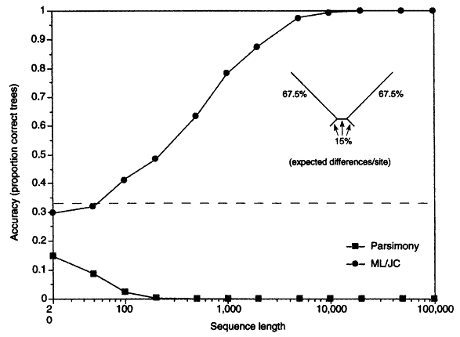
Likelihood vs. parsimonie
LONG BRANCH ATTRACTION
Swofford et al,. Systematic Biology, 2001

Slide 30
FELSENSTEIN ZONE
Maximum likelihood is inconsistent estimator if the substitution model does not reflect reality
A
p
B
q
q
q
A
G
u
p
D
C
u
u
u
u
A
C
T
u
C
p
p
q
q
q
B
D

Slide 31
BAYESIAN METHOD
Prob (H D) =
Prob (H) Prob (D H)
Prob (H) Prob (D H)
_{H}

Slide 32
MARCOV CHAIN MONTE CARLO
T1
Equlibrium
T2
Prob (T2 D)
Probability of step from T1 to T2 depends at
Prob (T1 D)

Slide 33
POSTERIOR PROBABILITIES
Frequency, with which the hypothesis is visited during the equilibrium, is estimate of its posterior probability.
T1
Equilibrium
T2

Slide 34
MARKOV CHAIN IN ACTION
The progress can be evaluated by plotting the likelihoods
generations
Equilibrium distribution of hypotheses (trees)
lnL
Burn-in

Slide 35
MARKOV CHAIN IN ACTION
Sometimes a problem may arrise particularly in hypotheses with many parameters, where it takes a lot of time to sample the space well.
generation
0
:(
lnL

Slide 36
BAYES METHOD
Related to the maximum likelihood method.
It uses the same substitution models to calculate probabilities.
Estimates the posterior probability of the hypothesis and not just likelihood by using MCMC.
The advantage is that it also optimizes the topology, branch lengths and parameter values ​​of the substitution model. The more parameters it optimizes, the more time it takes to reach equilibrium.
Calculates statistical support for branching (about next time).

Slide 37
Likelihood vs Bayes

