Slide 1
EXAM
PARTS OF EXAM:
Written part (5 examples) – 10 points
Oral part (theory) – 5 points
ADDITIONAL POINTS
Homeworks (earn or loose) – 5 points in total
Essay (2-3 pages) and presentation – 4 points
Brain exercises – 10 points in total
EVALUATION:
11-13.5 points – dobře
14-17.5 points – velmi dobře
above 18 - výborně

Slide 2
ESSAY
Length: 2-3 pages of text.
Topic: Based on one or more articles from the field of molecular phylogenetics and taxonomy. In the essay, focus more on methods than results per se. Suggested articles will be available in Moodle, but you can choose also other. In this case, send me the article in advance to confirm the suitability.
Submission after Christmas via Moodle
Presentation 10 min. (8. January 2024)
Why to write it? 4 points

Slide 3


PROBABILITY OF BEING POSITIVE
What is the probability for patient being negative given the negative test.
Antigenic COVID test:
Sensitivity (probability of positive test in positive patient) 80%
Specificity (probability of negative test in negative patient) 99,2%
Prevalence of the dissease in population 1%
0.99 * 0.992
0.997 =
0.99 * 0.992 + 0.01 * 0.2

Slide 4
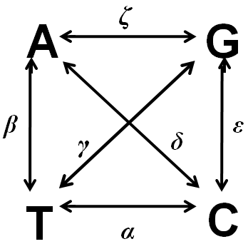
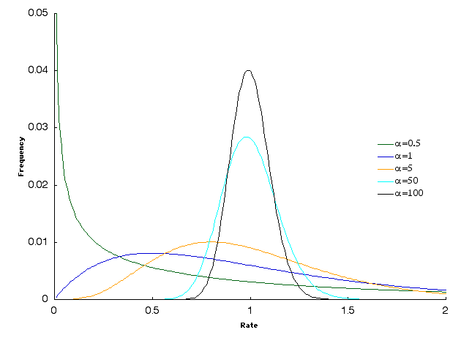
MAXIMUM LIKELIHOOD
DATA
HYPOTHESIS
Taxon A CCCTGG
Taxon B ACTTGA
Substitution model: GTR + Γ
P(t) = 1/4 e^{r1Qt} + 1/4 e^{r2Qt}
+ 1/4 e^{r3Qt} + 1/4 e^{r4Qt}
Distance (branch length)
t
A
B
L = P(A|C,t) * P(C|C,t) * P(T|C,t)…..
Values of parameters we calculate from data (π) or we use those that maximise the likelihood (rates α,β,γ,δ,ε,ζ and α parameter of function Γ)

Slide 5
MAXIMUM LIKELIHOOD
Calculate the approximate length of the branch for a DNA alignment of two sequences with a length of 100 positions, which differs in 15 positions. Consider the substitution model JC and use the maximum likelihood method
DATA
HYPOTHESIS
Taxon A XX
Taxon B YX
Substitution model: Jukes Cantor
P_{ii} = ¼ + ¾ e^{-4/3t}
P_{ij} = ¼ - ¼ e ^{-4/3t}
Distance (branch length)
t
A
B
L = (¼ + ¾ e^{-4/3t})⁸⁵ * (¼ - ¼ e ^{-4/3t})¹⁵

Slide 6
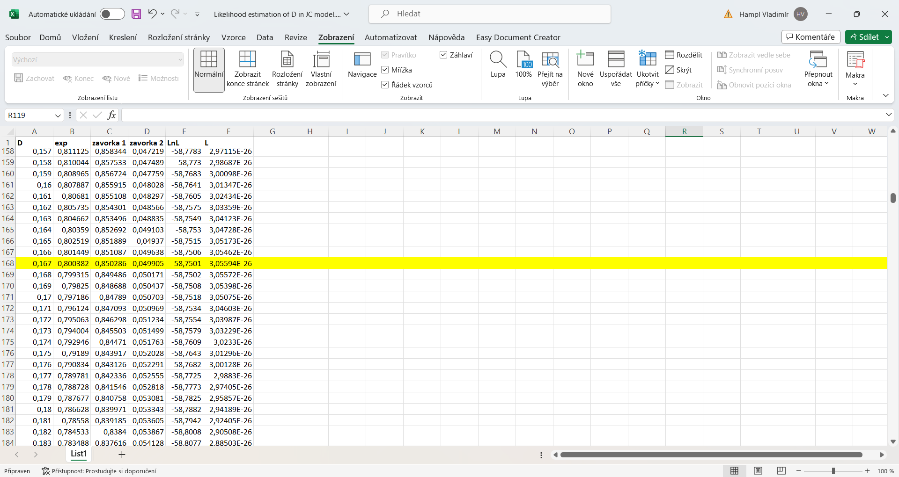
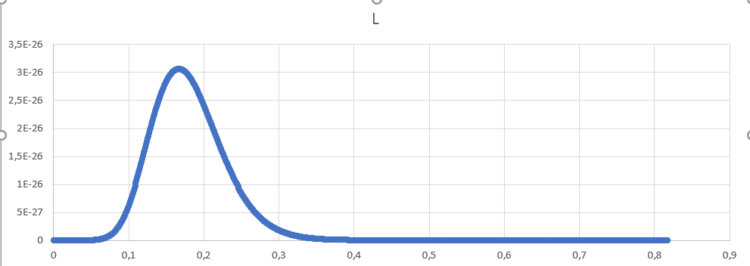
MAXIMUM LIKELIHOOD

Slide 7
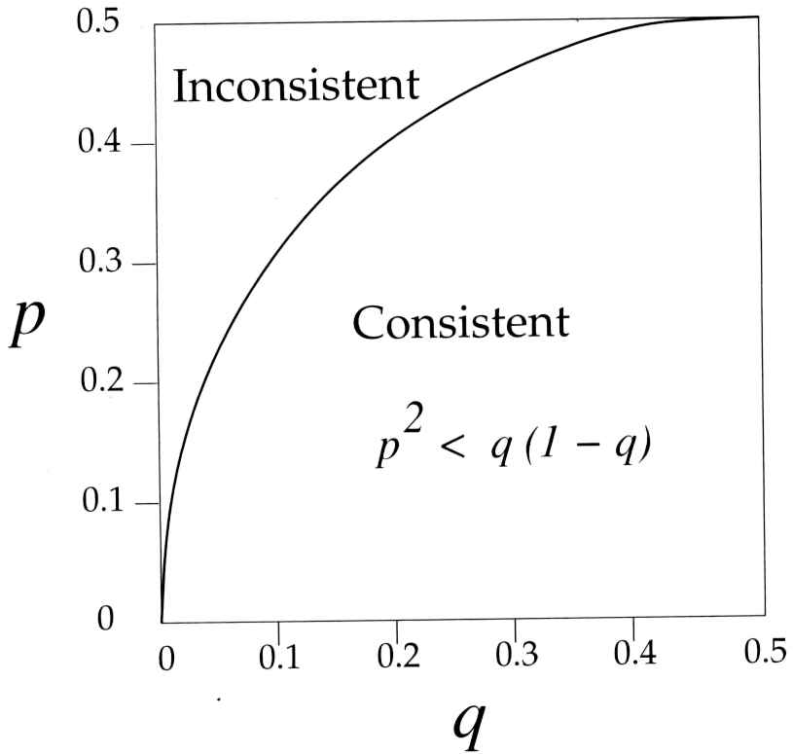
FELSENSTEIN ZONE
Maximum likelihood is consistent is the substitution model is realistic

Slide 8
EVEN BETTER MODEL
What else to relax?
P(t) = e^{Q3t}
t₁
t₂
P(t) = e^{Q1t}
P(t) = e^{Q2t}
t₃
P(t) = e^{Q4t}
P(t) = e^{Q5t}
t₄
t₅
ACCTGGATGC
ACTTGAATGC
ACTTCGATGG
ACTTCAAGGG
P(t) = e^{QXt}
P(t) = e^{QYt}
P(t) = e^{QZt}
P(t) = e^{QWt}
P(t) = e^{QVt}

Slide 9
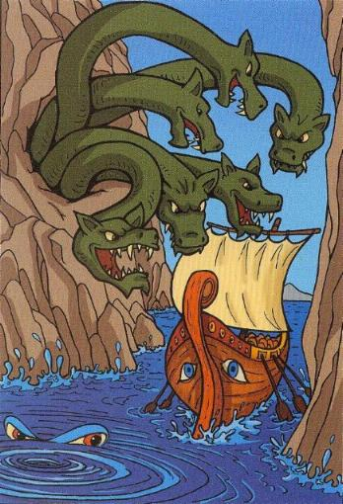
OVERPARAMETRISATION
Alignment 10 taxa with 1000 amino acids:
17 branch lengths, 17 x 190 x 1000 rates (Q for branches and positions)
=> Over 3 millions of paramaters

Slide 10
EVEN BETTER MODEL
What else to relax?
Covarion (MrBayes)
CAT (Phylobayes),
LG4X (RAxML), 4 cathegories of positions, independent from Gamma
C10, C20, C60, PMSF (IQtree)
P(t) = e^{Q3t}
t₁
t₂
P(t) = e^{Q1t}
P(t) = e^{Q2t}
t₃
P(t) = e^{Q4t}
P(t) = e^{Q5t}
t₄
t₅
ACCTGGATGC
ACTTGAATGC
ACTTCGATGG
ACTTCAAGGG
P(t) = e^{QXt}
P(t) = e^{QYt}
P(t) = e^{QZt}
P(t) = e^{QWt}
P(t) = e^{QVt}

Slide 11
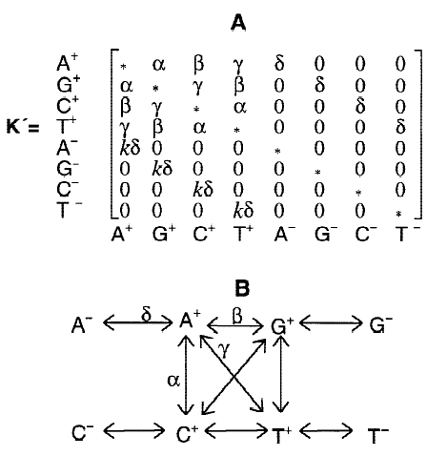
COVARION
Penny a kol. 2001

Slide 12
CONSENSUS TREE
Topologies containing identical set of OTUs can be combined into one.
There are several ways, how to do it.

Slide 13
FIND TWO IDENTICAL TOPOLOGIES
A
C
D
2
B
C
1
D
B
C
A
D
E
B
E
D
3
C
A
E
B
C
B
C
4
5
A
E
D
A
B
D
E
E
A

Slide 14
FIND TWO IDENTICAL TOPOLOGIES
1
2
C
B
D
A
A
B
B
C
A
D
D
E
E
E
C
3
4
5
E
A
A
A
B
B
B
D
C
D
E
E
C
C
D

Slide 15

BIPARTITIONS/SLITS
D
C
A
E
B
AB, ABC, CDE, DE

Slide 16
BIPARTITIONS/SLITS
C
A
A
B
B
D
D
E
E
C
AB, ABC, CDE, DE
AB, ABC, CDE, DE

Slide 17
STRICT CONSENSUS
Contain „bipartitions“/“splits“, which are present in all topologies.
B
B
A
B
A
A
E
E
E
C
C
C
D
D
D
ED/ABC
BC/AED
ED/ABC
AB/EDC
AE/DBC
BC/AED

Slide 18
STRICT CONSENSUS
Contain „bipartitions“/“splits“, which are present in all topologies.
B
B
A
B
A
A
E
E
E
C
C
C
D
D
D
B
A
E
C
D

Slide 19
STRICT CONSENSUS
Contain „bipartitions“/“splits“, which are present in all topologies.
B
A
B
A
E
E
C
C
D
D
ED/ABC
BC/AED
B
AE/DBC
BC/AED
A
E
C
D

Slide 20
MAJORITY RULE CONSENSUS
Contain splits present majority of topologies.
B
B
A
B
A
A
E
E
E
C
C
C
D
D
D
ED/ABC
BC/AED
ED/ABC
AB/EDC
AE/DBC
BC/AED
B
A
E
D
C

Slide 21
EXTENDED MAJORITY RULE CONSENSUS
Adds other most common splits to majority rule consensus until the topology is fully ressolved (contains only dichotomies)
A
B
A
B
A
B
E
E
E
B
D
F
C
D
F
C
D
F
C
F
A
F
F
E
E
A
B
E
A
B
D
C
D
C
C
D
A
B
A
B
E
E
C
C
5/7
D
D
F
F

Slide 22
EXTENDED MAJORITY RULE CONSENSUS
Adds other most common splits to majority rule consensus until the topology is fully ressolved (contains only dichotomies)
A
B
A
B
A
B
E
E
E
B
D
F
C
D
F
C
D
F
C
F
A
F
F
E
E
A
B
E
A
B
D
C
D
C
C
D
A
B
A
B
E
E
C
C
3/7
D
D
F
F

Slide 23
QUESTIONS WE SHOULD ASK
Do my data (typically alignment) support the relationships on the tree I have inferred strongly or only weakly?
In my tree significantly better than some other tree?

Slide 24
WHY TO ASK SUCH ANNOYING QUESTIONS?
Our algorithms are developed to infer a tree, and so they will draw a tree from any data.
1 TCCGAGCAA
2 TCCGAGCAA
3 ACCGAGCAA
4 ACCGAGCAA
1
3
1 ACCGAATGA
2 ACCGAGCAG
3 GTTAGGCAG
4 GTTAGATGA
2
4

Slide 25
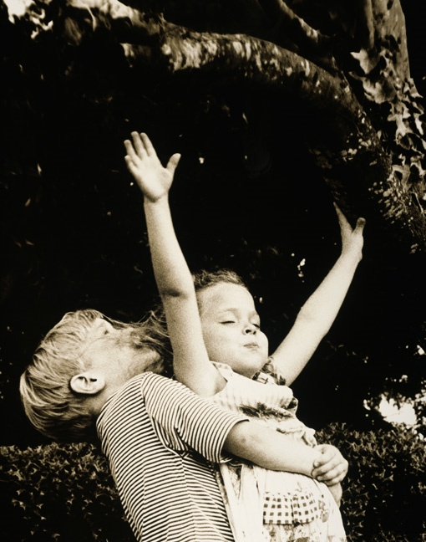
STATISTICAL SUPPORT OF BRANCHING

Slide 26
POSTERIOR PROBABILITIES
Frequency, with which the hypothesis is visited during the equilibrium, is estimate of its posterior probability.
T1
Equilibrium
T2

Slide 27
POSTERIOR PROBABILITIES OF NODES
Weak
Strong
0.53
1.0

Slide 28
Basic principle
RESAMPLING METHODS
Resample the original data by permutation and infer a tree.
Do it many times (1000x).
Compare the original tree with trees from the resamplings and indicate the matches on the original tree.

Slide 29
BOOTSTRAP
Resampling with replacement
Original alignment: n positions
Bootstrap alignment: n positions
But some positions will apprear multiple times, some will be absent.

Slide 30
BOOTSTRAP
Bootstrap
alignments
Trees
Bootstrap alignments
(n repetitions)
Alignment
515621
123456
A catcga
B ccgggt
C gcggga
D gaacgt
364122
615343
414436
Reconstructed tree
Marking the bootstrap values on the original tree.

Slide 31
BOOTSTRAP
Map the bootstrap supports on the original tree.
Bootstrap of a
bipartition/split) indicates the frequency, with which
this split occurs among the bootstrap replicates.
Strong
95
Weak
55

Slide 32
BOOTSTRAP
C
B
D
A
A
B
B
C
A
C
D
D
E
E
E
A
C
B
E
A
A
A
D
B
B
C
D
C
D
E
E
E
B
C
D

Slide 33
BOOTSTRAP
C
B
D
A
A
B
B
C
A
C
D
D
E
E
E
A
C
0,5
B
E
A
A
A
D
B
B
C
0,5
D
C
D
E
E
E
B
C
D

Slide 34
COMPULSORY ASSIGNMENT
D
C
B
A
B
B
A
E
E
D
C
C
A
E
D
D
C
A
E
B
C
B
D
A
A
B
C
B
C
A
D
D
A
E
E
E
C
E
A
A
B
A
B
B
D
C
D
C
D
E
E
E
B
C
D

Slide 35
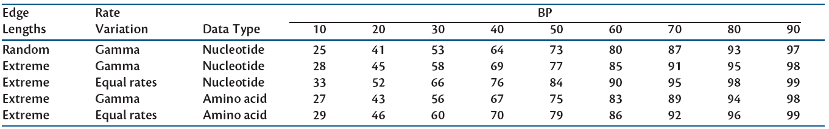
BOOTSTRAP
Bootstrap does not behave like the statistic p-value. 95% bootstrap does not mean that we can reject alternative splits at the probability level 5%.
There is a method how to transform BP to aBP (adjustedBP), which behave as p-value. Simulations showed that aBP are generally higher than BP. Bootstrap 80 corresponds approximately to 95% and 90 corresponds to approx. 98-99%.
Accelerated algorithms: RELL, RAxML rapid BS, aLRT, UFboot (the latter provides values similar to p-value)
Software: http://www.mathstat.dal.ca/~tsusko/src/aBPn.exe

Slide 36
JACKKNIFE
Other resampling methods
Ressampling without replacement selects k% of sites.

Slide 37
JACKKNIFE
50% jackknife
Jackknife
alignments
Trees
Jackknife alignments
(n repetitions)
Alignment
342
123456
A catcga
B ccgggt
C gcggga
D gaacgt
136
514
256
Reconstructed
tree
Marking the jackknife values on the original tree.

Slide 38
TESTS OF TOPOLOGY HYPOTHESES
L1
L0
δ= ln L1-lnL0
Is L1 significantly higher than L0?
We need to know the distribution of δ statistic.

Slide 39
TESTS OF TOPOLOGY HYPOTHESES
L₁L₂L₃L₄L₅L₆
A catcga
B ccgggt
C gcggga
AU test
Calculate
„site likelihoods“ L₁, L₂, L₃, L₄, L_{5,} L₆ L₁, L₂, L₃, L₄, L_{5,} L₆
Perform permutation of
„site likelihoods“
and calculate total
Likelihood L1= L₁*L₂* L₂* L₃*L₄* L₂ L0= L₁*L₂* L₂* L₃*L₄* L₂
Calculate δ δ= lnL₁-lnL₀
Repeat many times Percent of cases, in which δ ≤ 0 is the p-value
for H0 rejection

Slide 40
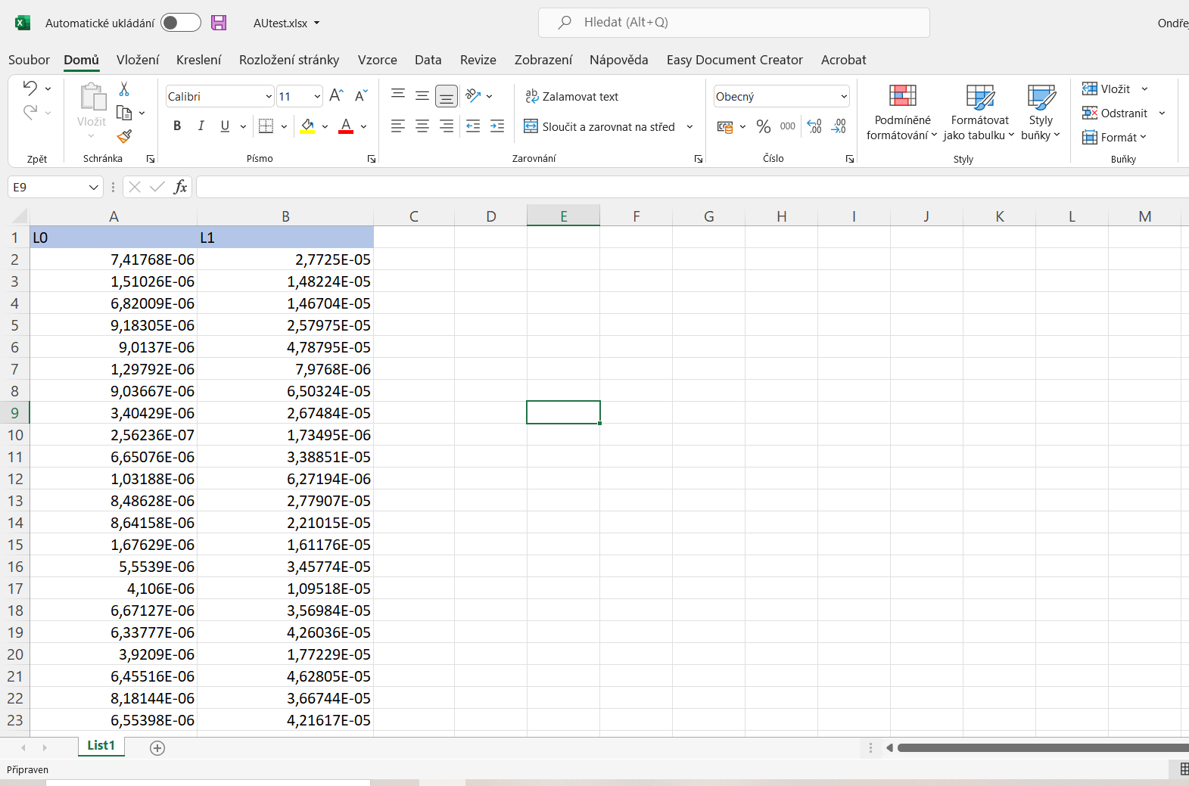
BRAIN EXERCISE
Given the likelihoods for null hypothesis (L0) and likelihoods for alternative hypothesis (L1) for 500 replicates, calculate the p-value for rejection of null hypothesis.

